Slide 1


How youtube can be financially successful?
Jinwoo Han
Zeyu Lei
Ankita Kumari
Yueheng Li

Slide 2

Problem Statement & Initial Questions
The objective of this project is to develop a comprehensive system for analyzing YouTube data to answer two primary questions:
How does our project's dashboard simplify the process for new YouTube creators to begin their journey, enhancing their content and revenue, while fostering a successful community of digital producers?
How can we identify trending content on YouTube to strategically position advertisements, ensuring advertisers reach the widest and most relevant audience?

Slide 3
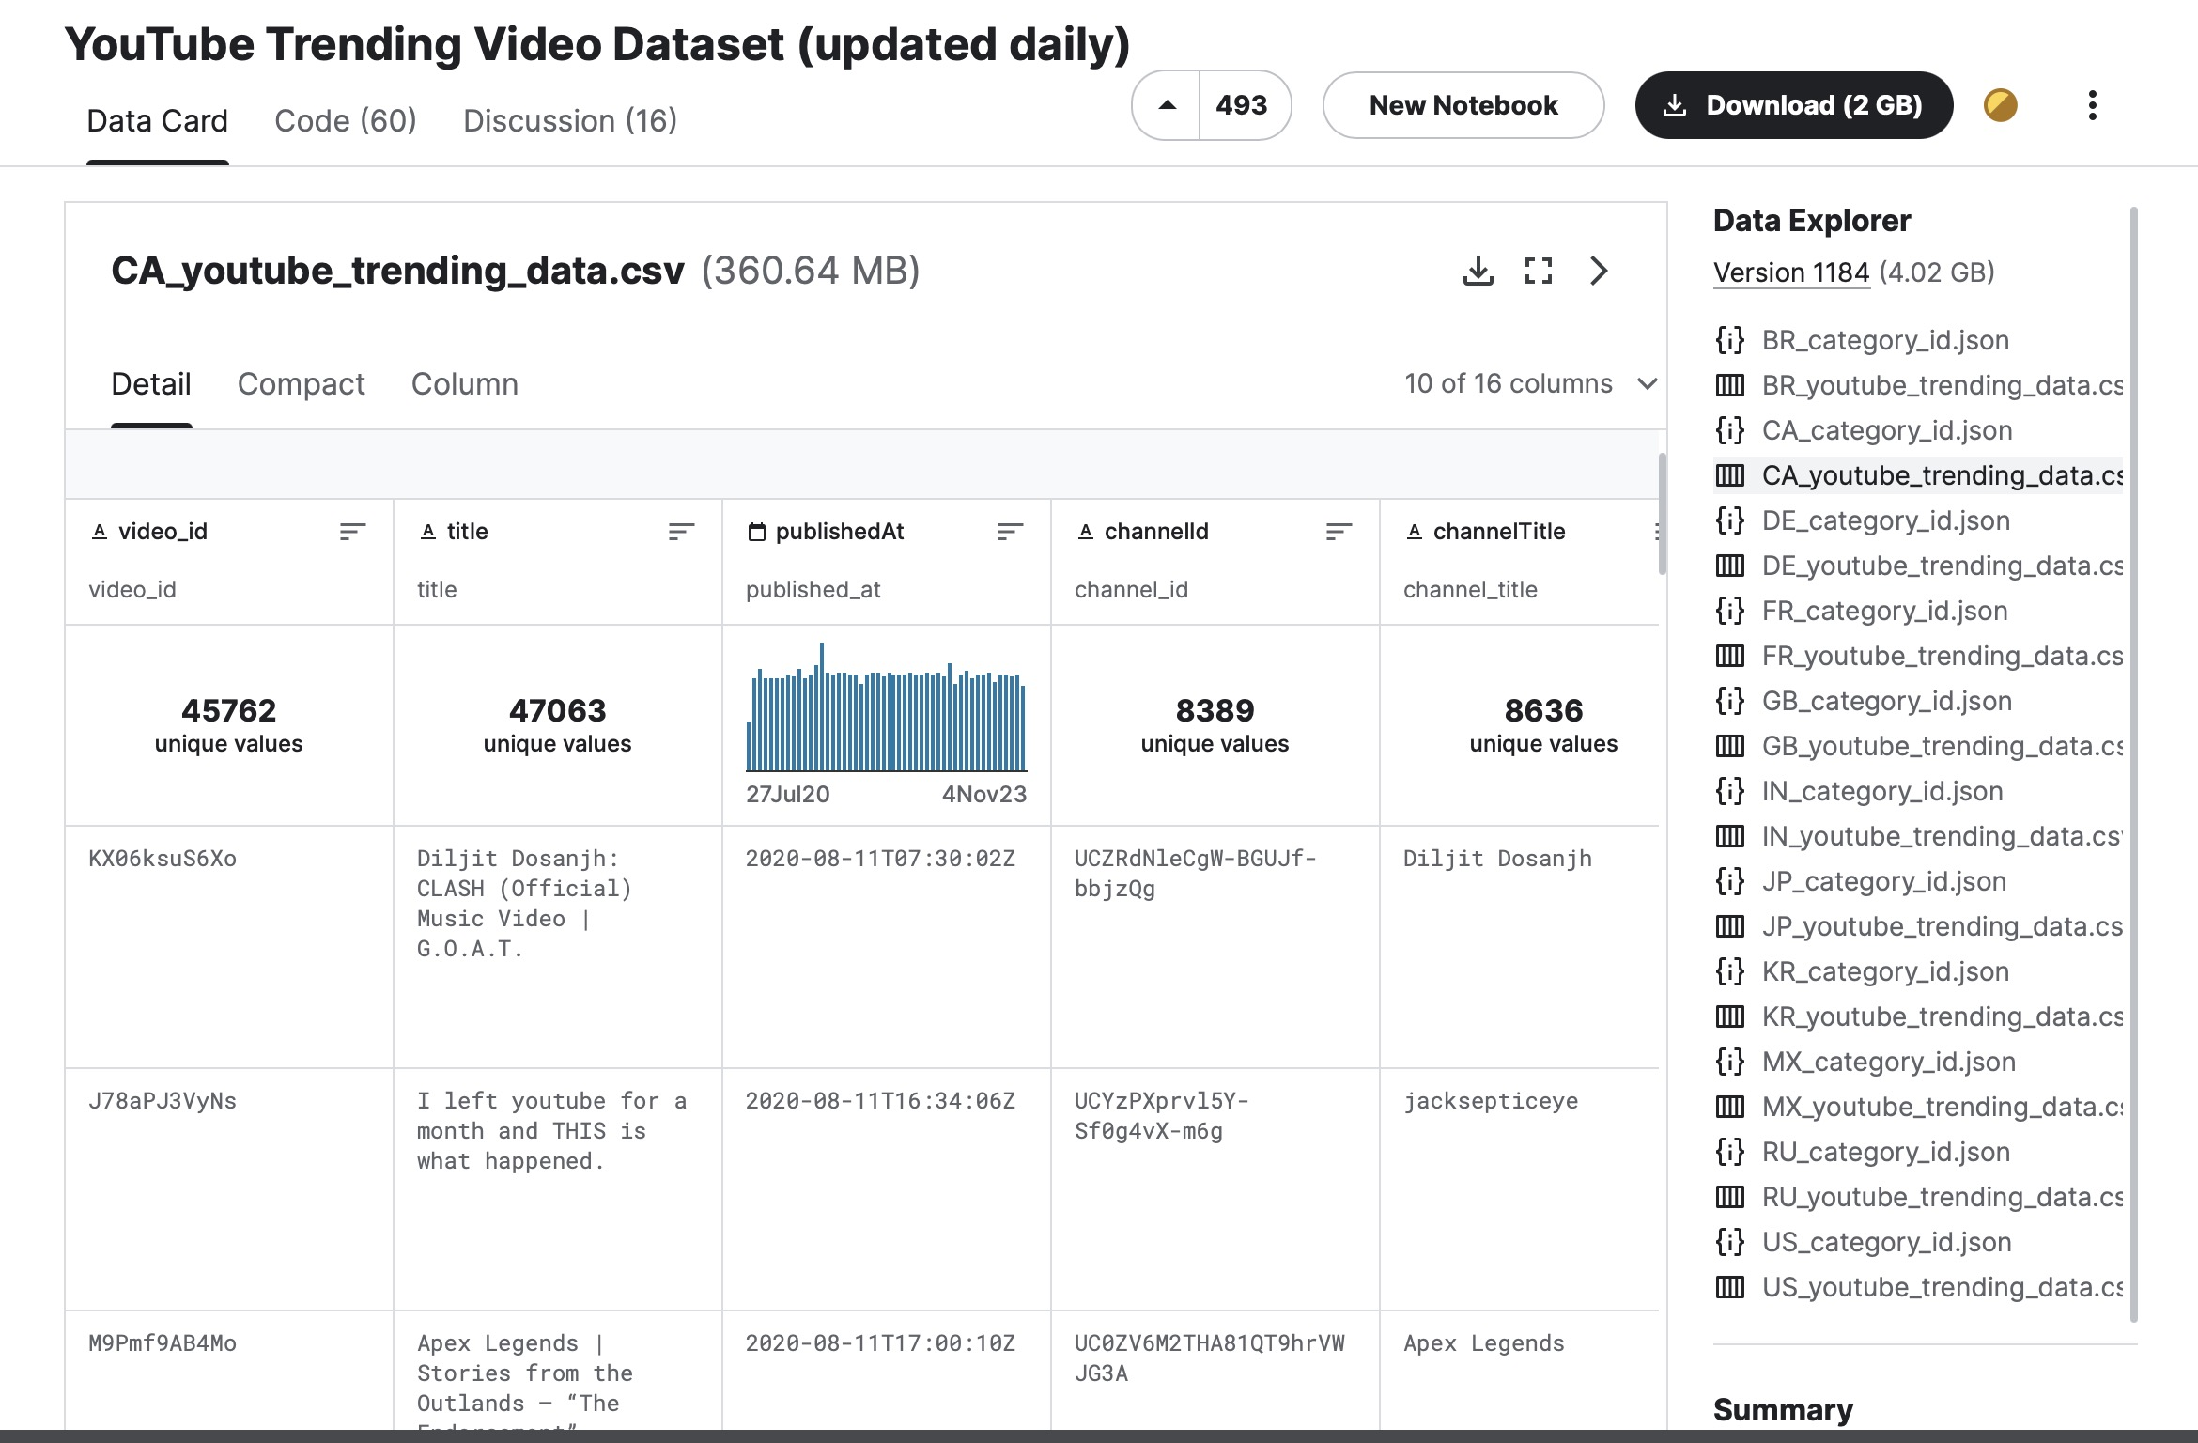

Slide 4
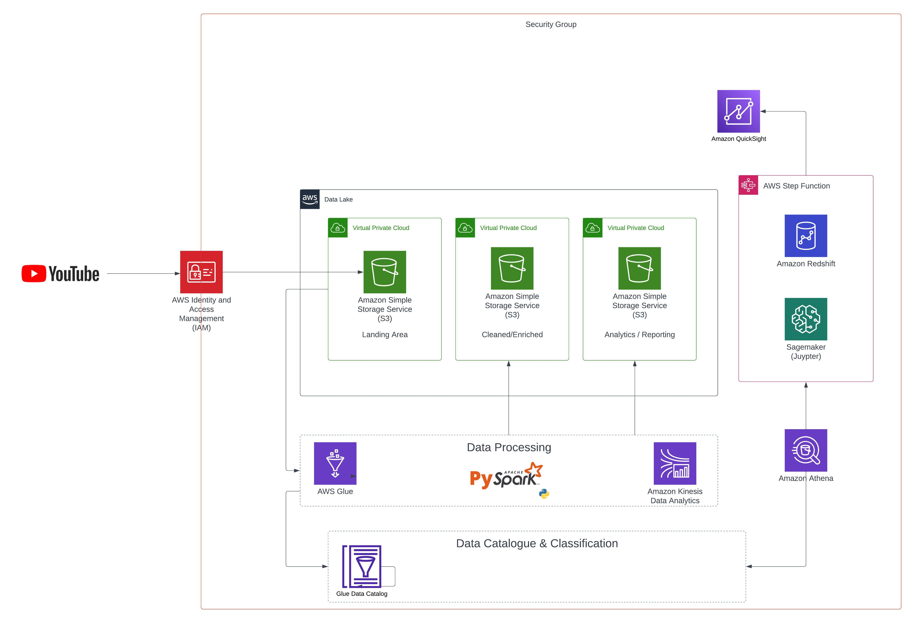
Notes:
Developed a pipeline to load unstructured YouTube Data into AWS S3, then harnessed AWS Data Wrangler based on Python for data wrangling. The refined data was subsequently loaded into Amazon Redshift by building AWS Glue pipeline, ensuring data integrity and readiness for advanced querying and analytics

Slide 5

Data Repository Selection and Integration
Our project entails transferring data from the Kaggle API, which is updated daily from YouTube's API, into an Amazon S3 bucket. This is a key component of your Lake House architecture. Utilizing Amazon S3 for this purpose ensures secure and accessible storage, perfectly suited for both structured and semi-structured data. This arrangement not only facilitates efficient data management but also broadens the scope for comprehensive analysis, leveraging Kaggle's extensive datasets within your Data Lake environment.

Slide 6

Data Ingestion and Collection
Data will be ingested in batches and on demand where necessary, ensuring the system can handle one-off data extraction as well as incremental loads.

Slide 7

Data Governance
A governance framework will be established, focusing on the security and privacy of data using AWS IAM for fine-grained access control.

Slide 8
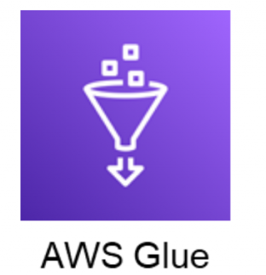
Data Analysis and Mining Techniques
AWS Glue will be utilized for data cataloging and preparation, while Amazon SageMaker Jupyter Notebooks will be used for developing machine learning models.
To enhance video categorization and predict popularity, techniques like sentiment analysis on comments and time series analysis on viewership statistics will be applied.
Amazon Athena capitalize on SQL queries for data operations, including aggregation, joining, and filtering.
Notes:
Leveraged Amazon Athena and Amazon SageMaker for advanced data analysis, employing machine learning algorithms for sentiment analysis, time series, and regression analysis to predict video popularity and viewer engagement patterns.

Slide 9

Data Visualization
Customized dashboards and reports in AWS QuickSight leverage Athena, refining visualizations through SQL queries for meaningful insights. These tools enable content creators and marketers to make informed decisions and improvements based on categorized video data and popularity factors.
Notes:
Designed and implemented interactive dashboards in AWS QuickSight, connected to Redshift and Athena to visualize and interpret categorized data and popularity factors.

Slide 10


Why Cloud Platform & Why AWS
Big Data demand
Integrated Services
Cooperation
Notes:
Developed a pipeline to load unstructured YouTube Data into AWS S3, then harnessed AWS Data Wrangler based on Python for data wrangling. The refined data was subsequently loaded into Amazon Redshift by building AWS Glue pipeline, ensuring data integrity and readiness for advanced querying and analytics

Slide 11
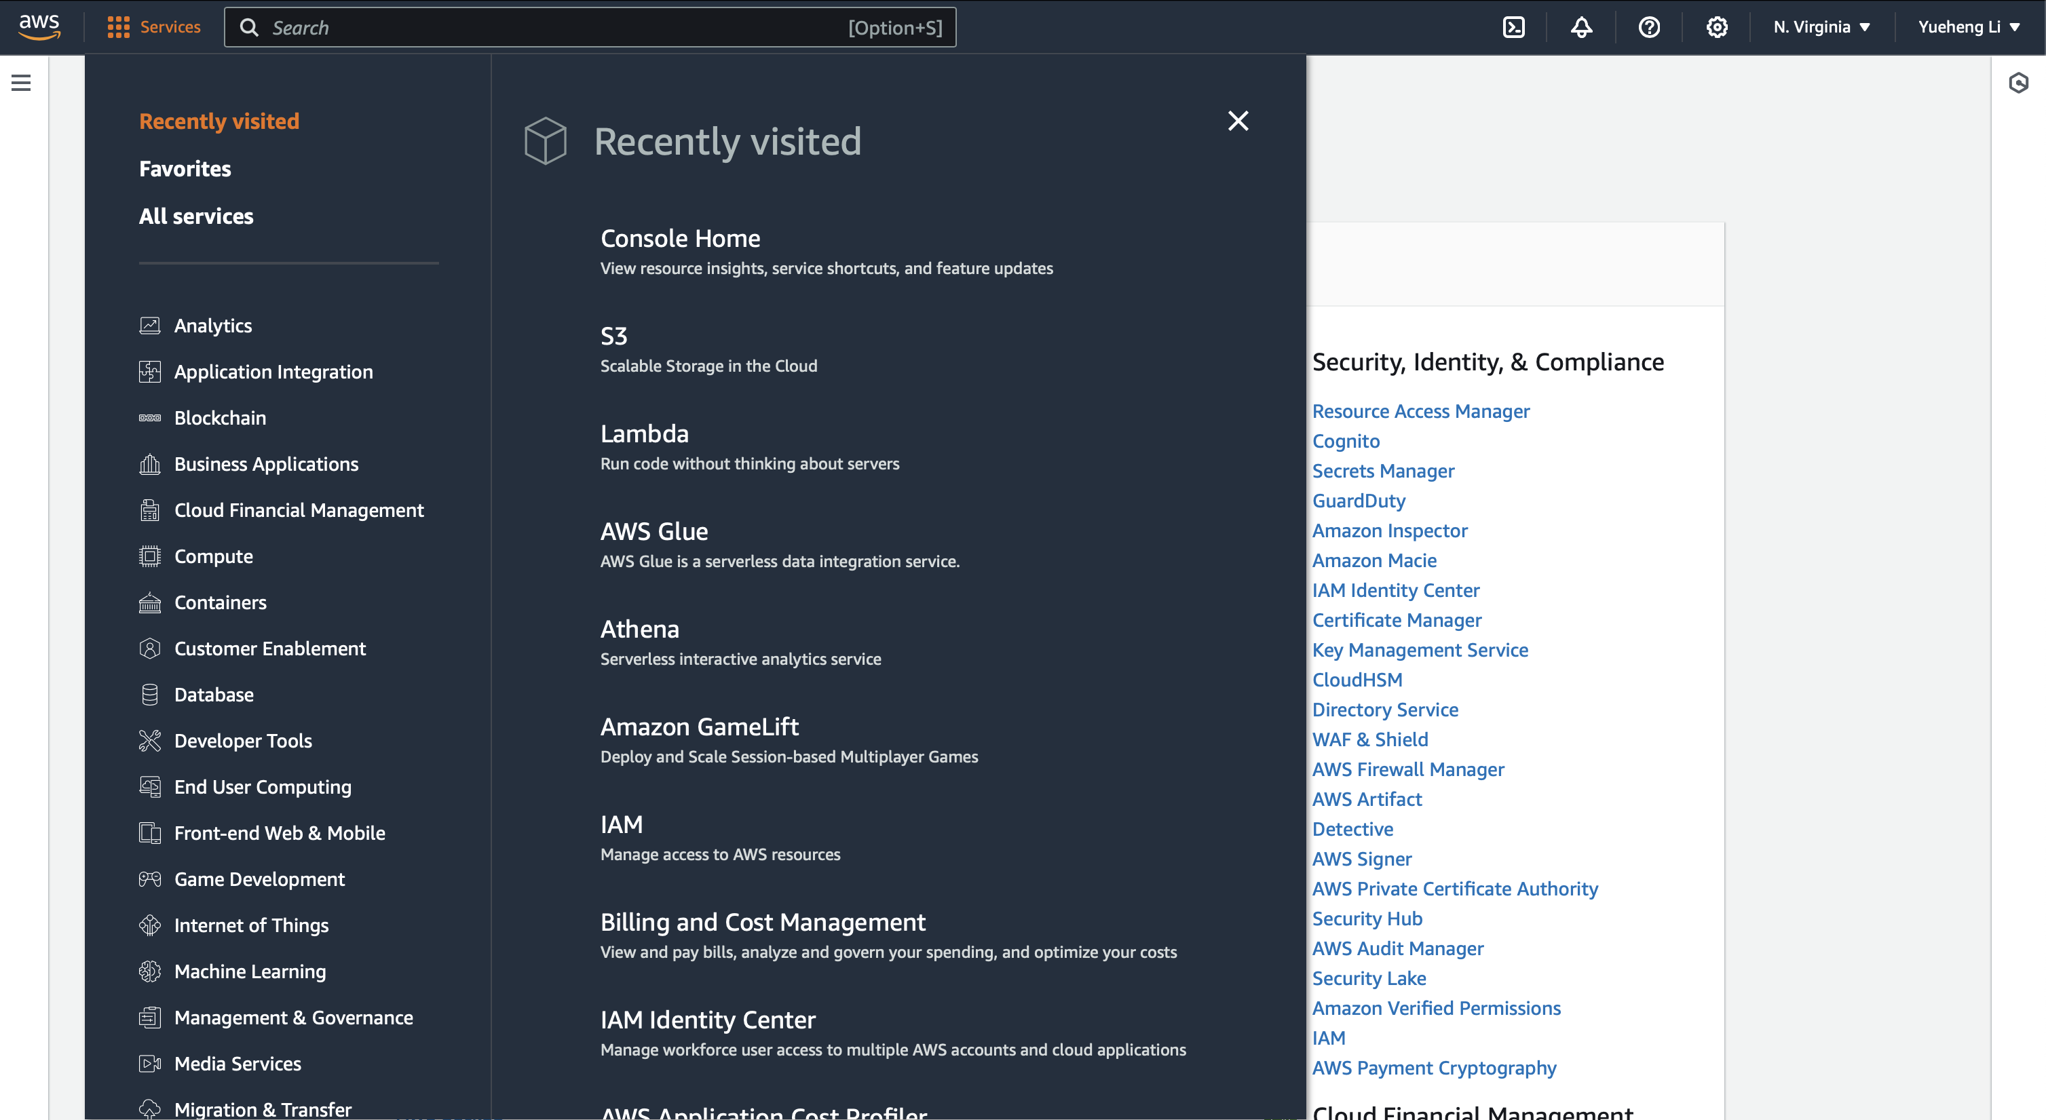
Why Cloud Platform & Why AWS
Big Data demand
Integrated Services
Notes:
Devel

Slide 12
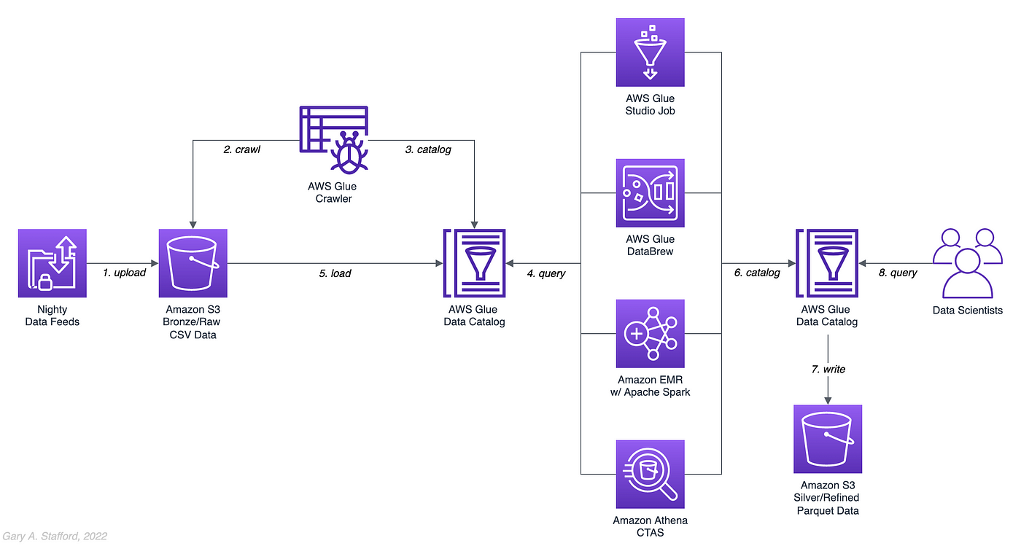
ETL Pipeline Overview
YouTube Data
Notes:
load: Raw YouTube data is uploaded to an Amazon S3 bucket. This is the initial stage where data in CSV format is stored in what is often referred to as a 'data lake'. The S3 bucket acts as a Bronze or Raw layer indicating that the data is in its initial raw state.
Crawl: An AWS Glue Crawler is used to scan the S3 bucket and infer schemas. It classifies the data and creates metadata tables in the AWS Glue Data Catalog.
Catalog: The tables created by the AWS Glue Crawler are stored in the AWS Glue Data Catalog, which is a centralized metadata repository.
Query: The AWS Glue Data Catalog can now be used to query and access the data using services like Amazon Athena or Amazon Redshift Spectrum.
Load: Data is loaded and possibly transformed using AWS Glue Studio Jobs, which can execute ETL scripts.
AWS Glue DataBrew: This is a visual data preparation tool that allows you to clean and normalize data without writing code.
Amazon EMR with Apache Spark: This is a managed cluster platform that simplifies running big data frameworks, such as Apache Spark, to process large datasets.
Amazon Athena CTAS: This is an operation that stands for "Create Table As Select", which is used in Amazon Athena to create a new table from the results of a SELECT query on another table.
Write: The processed and transformed data is written back to an Amazon S3 bucket. This time, it's stored as Parquet, which is a columnar storage file format optimized for queries.
Data Scientists Query: Data scientists or analysts can query the cleaned, transformed, and structured data using SQL queries in Athena or through other analytics tools connected to the AWS Glue Data Catalog.
Developed a pipeline to load unstructured YouTube Data into AWS S3, then harnessed AWS Data Wrangler based on Python for data wrangling. The refined data was subsequently loaded into Amazon Redshift by building AWS Glue pipeline, ensuring data integrity and readiness for advanced querying and analytics

Slide 13
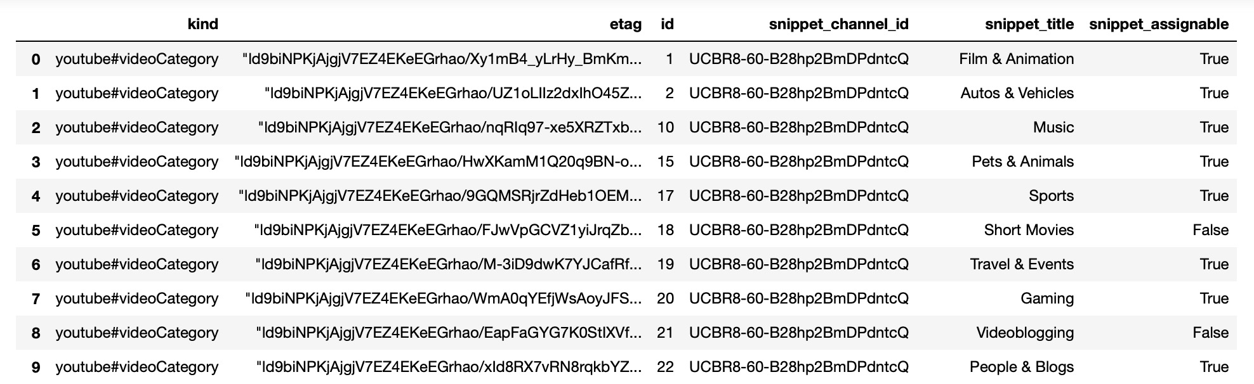
About our Data: Category Type(JSON)
11 regions have different category lists
https://www.kaggle.com/datasets/rsrishav/youtube-trending-video-dataset/data?select=BR_youtube_trending_data.csv
Notes:
Developed a pipeline to load unstructured YouTube Data into AWS S3, then harnessed AWS Data Wrangler based on Python for data wrangling. The refined data was subsequently loaded into Amazon Redshift by building AWS Glue pipeline, ensuring data integrity and readiness for advanced querying and analytics

Slide 14
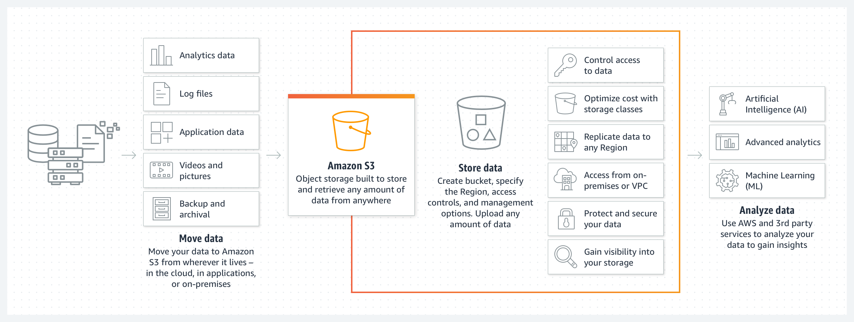
AWS S3-Data lake

Slide 15
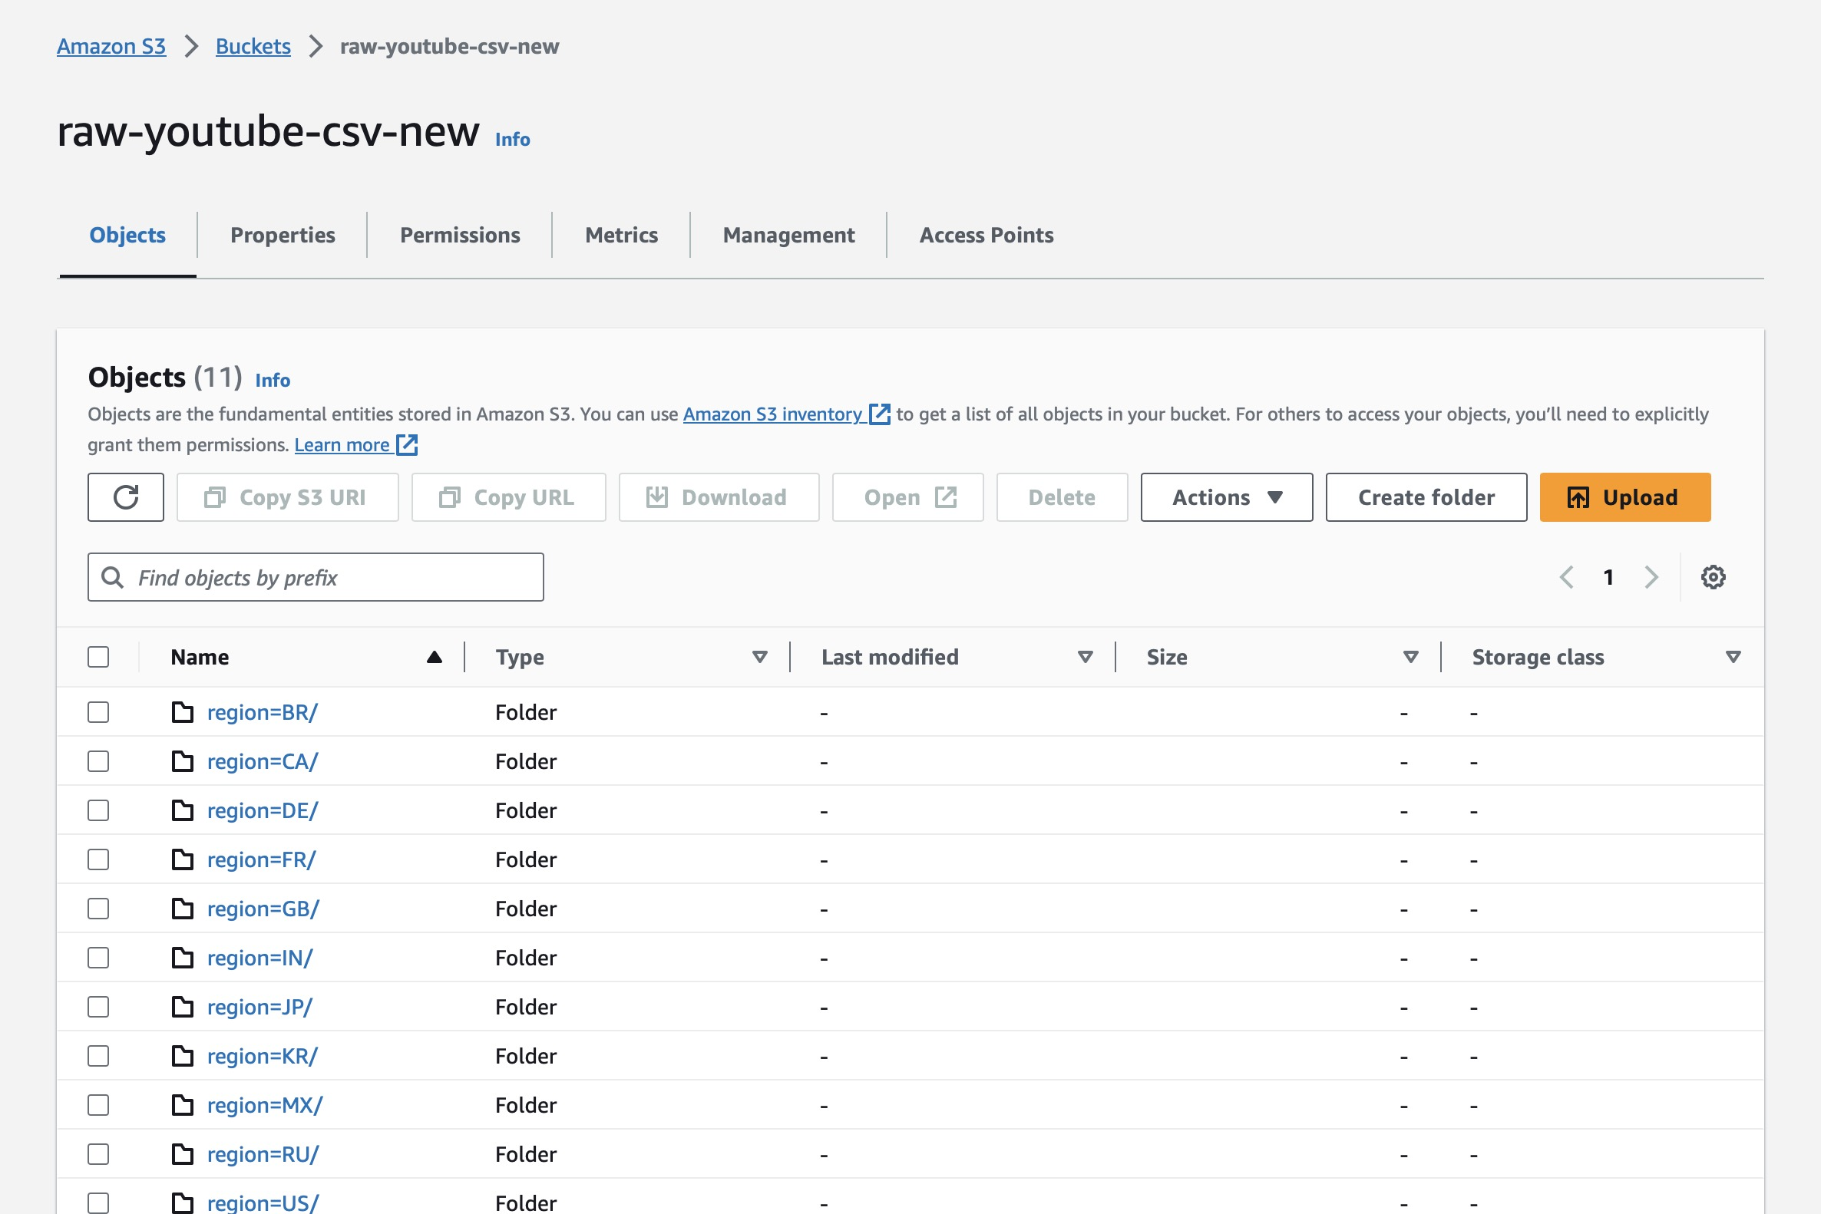
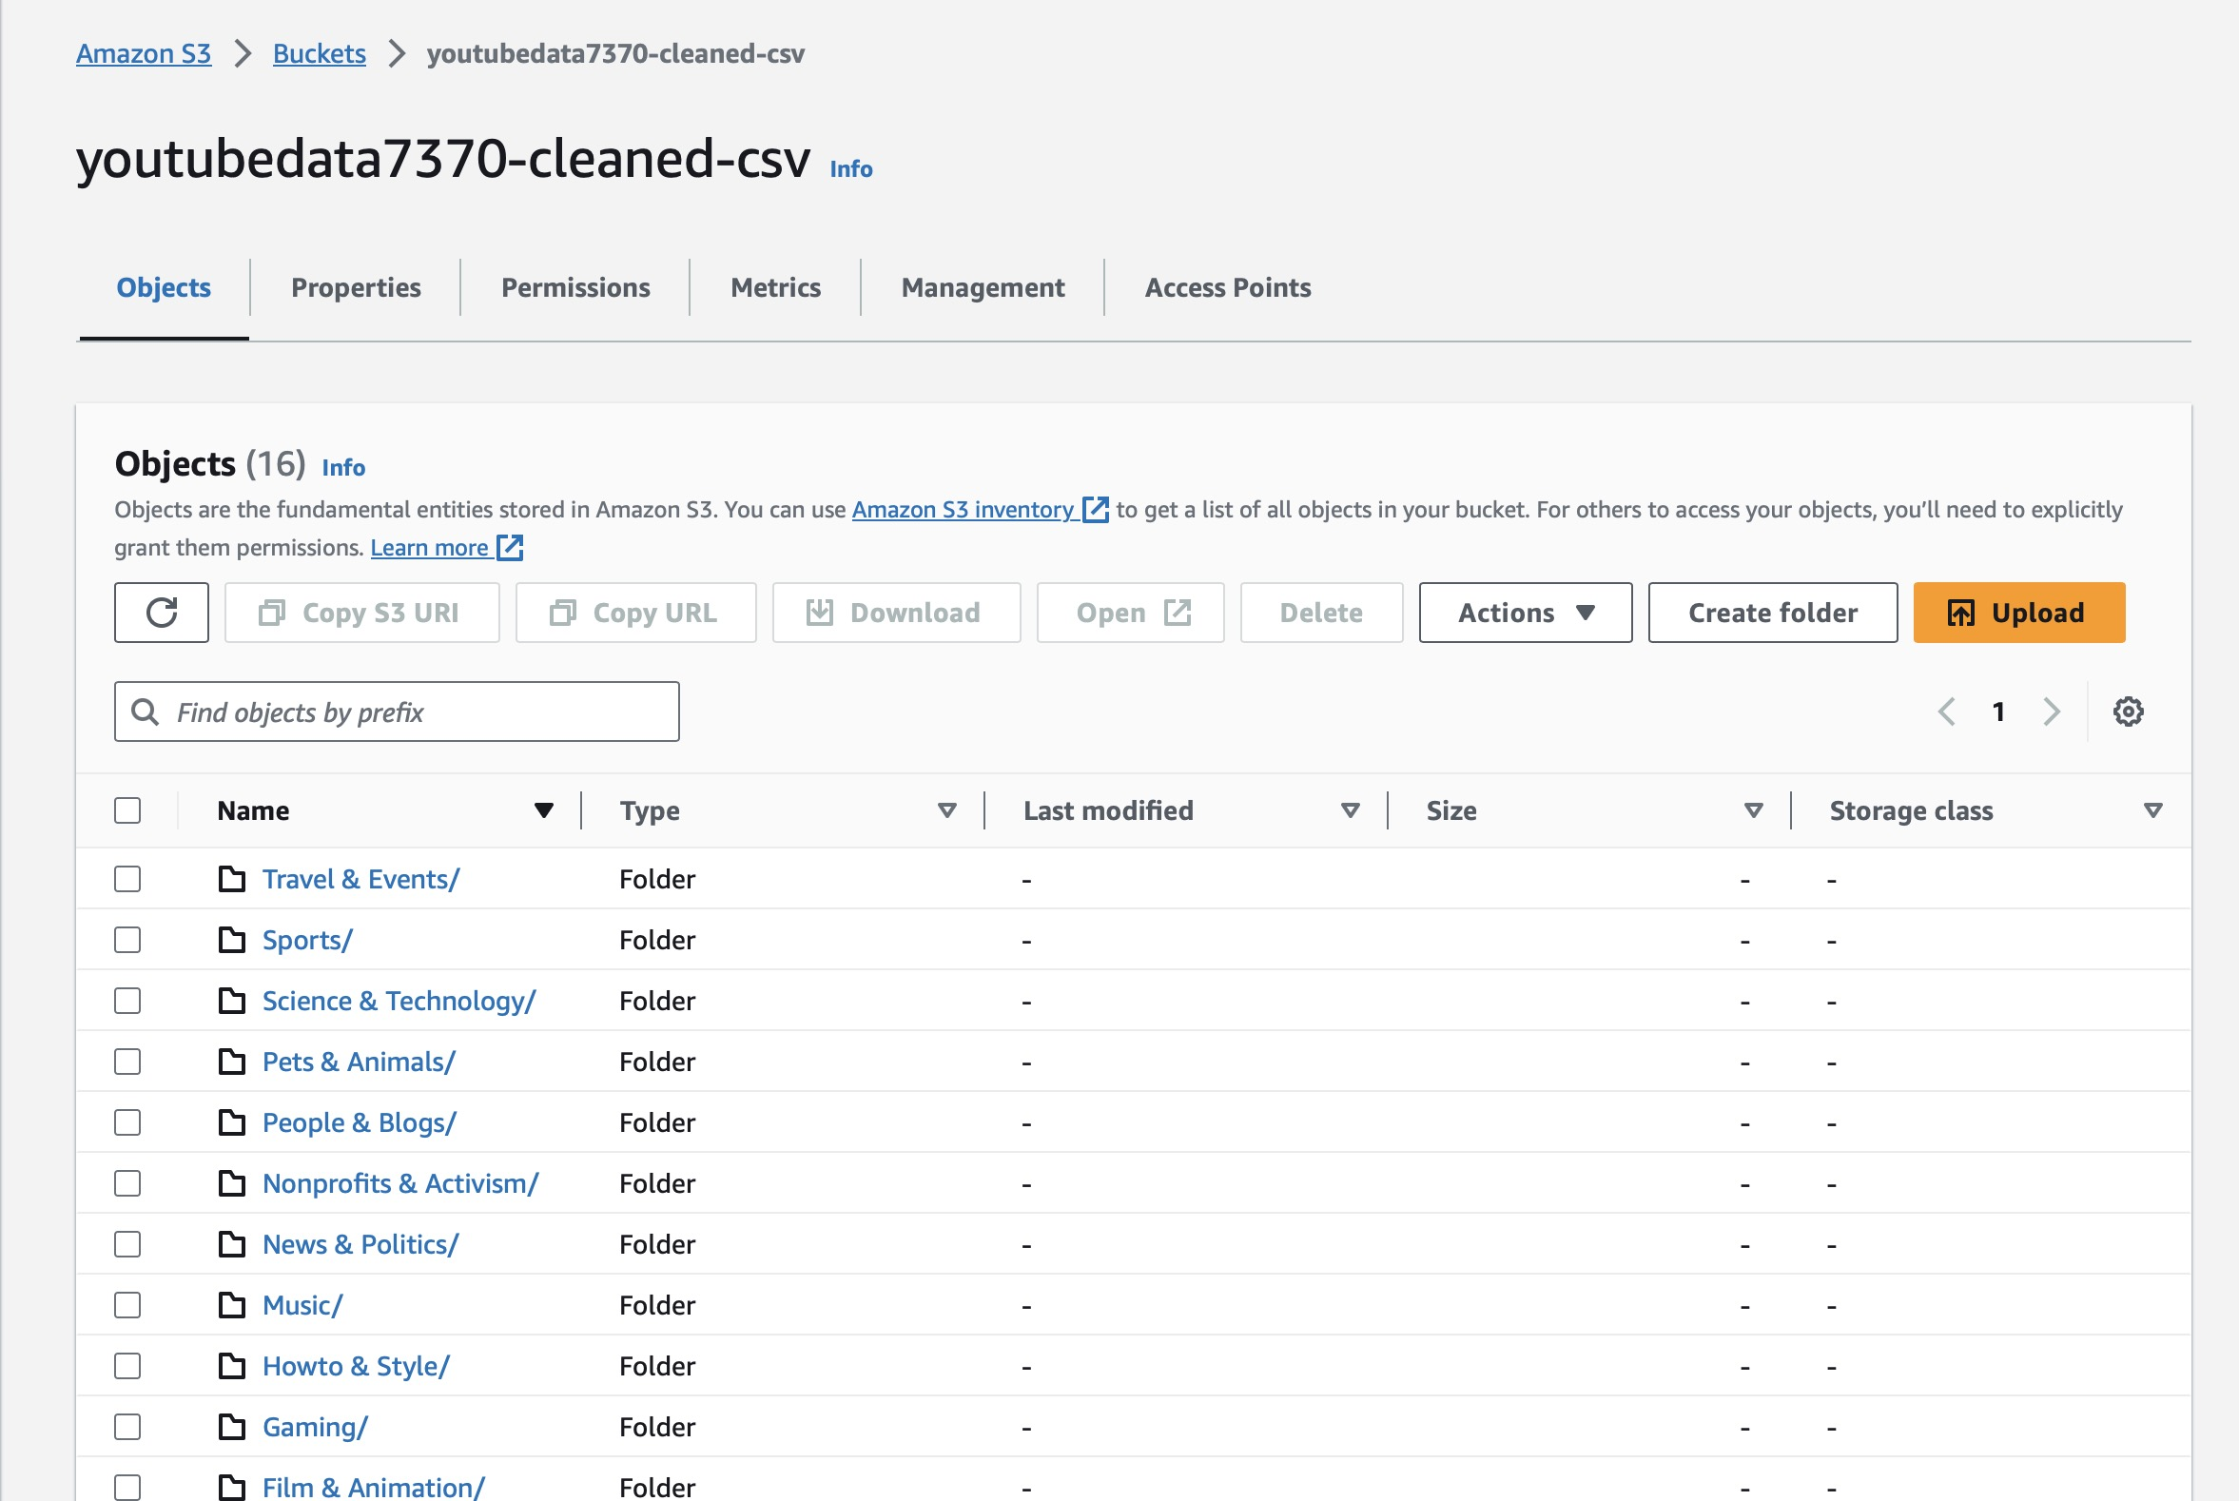
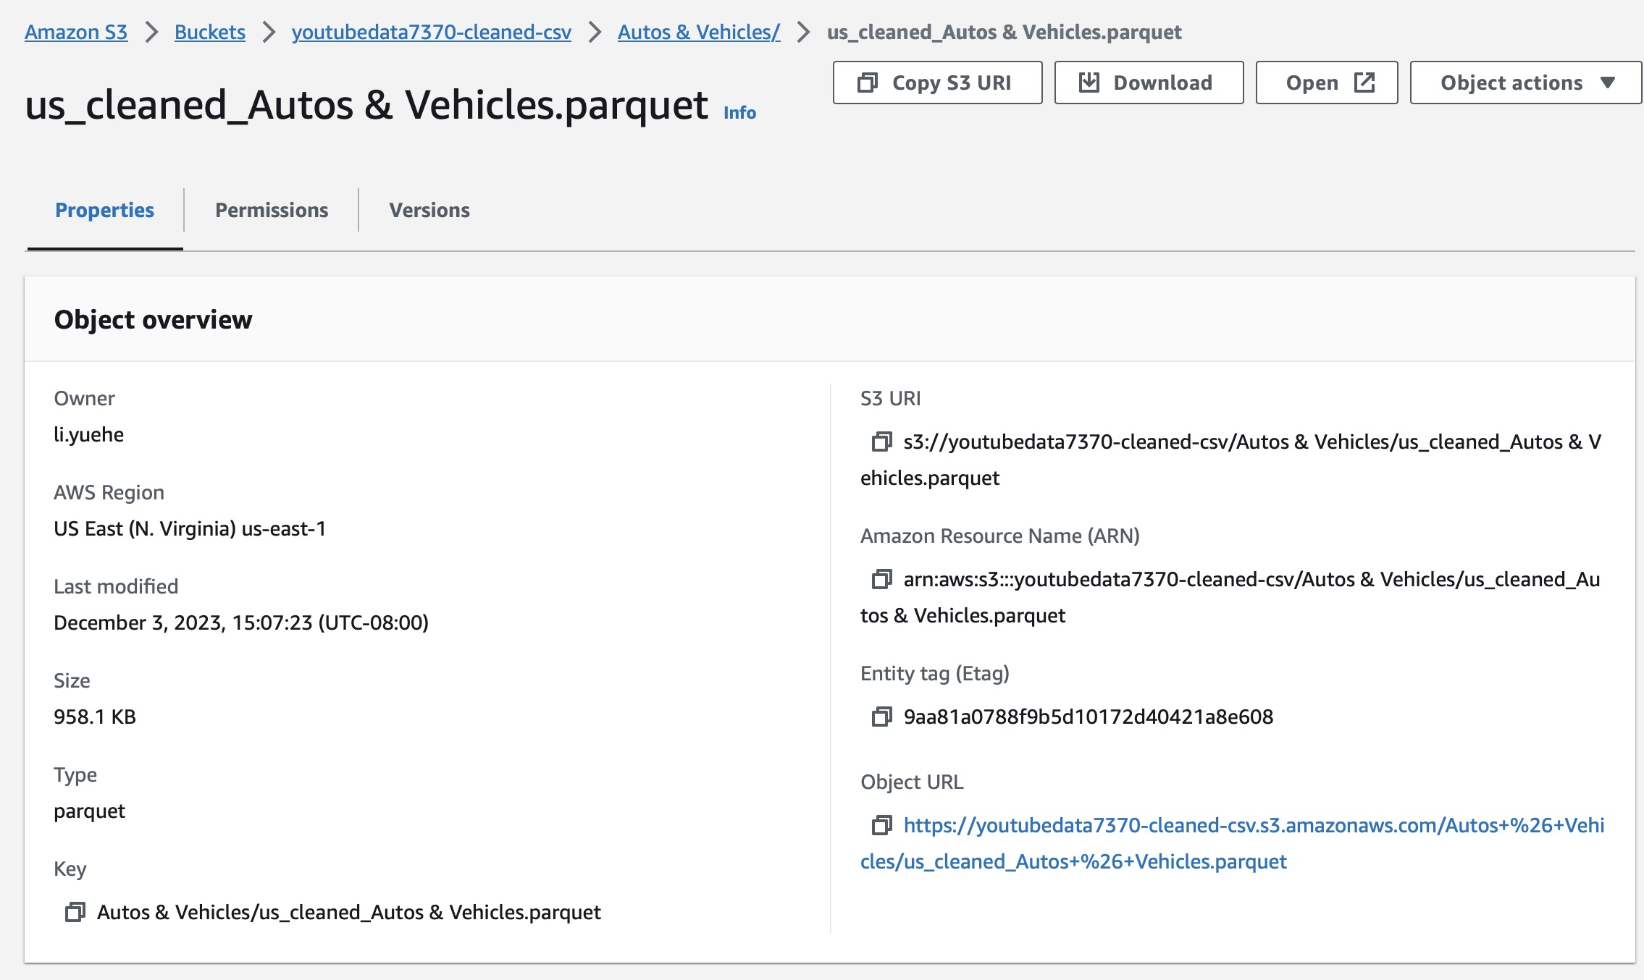
AWS S3 Our Data

Slide 16
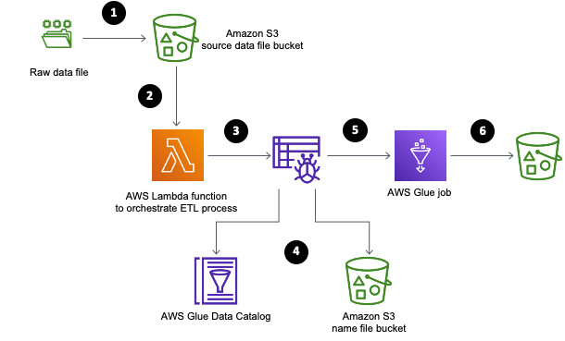
AWS Lambda
Event-Driven
Language Support
Customizable
Performance Monitoring
Cost-Effective
Notes:
AWS Lambda is a compute service provided by Amazon Web Services (AWS) that lets you run code without provisioning or managing servers. It's an event-driven platform that executes your code in response to triggers such as changes in data, shifts in system state, or actions by users.
Event-Driven: Lambda functions are triggered by specific events from many AWS services, like S3 uploads and modification
Language Support: Supports multiple programming languages, including Node.js, Python, Ruby, Java, Go, .NET Core, and custom runtimes.
Customizable: Lambda allows you to bring in your own libraries, even native ones, or package your function as a container image.
Performance Monitoring: Integration with AWS CloudWatch to monitor and log your Lambda functions' performance.
Cost-Effective: With Lambda, you pay only for the compute time you consume. There's no charge when your code isn't running.

Slide 17
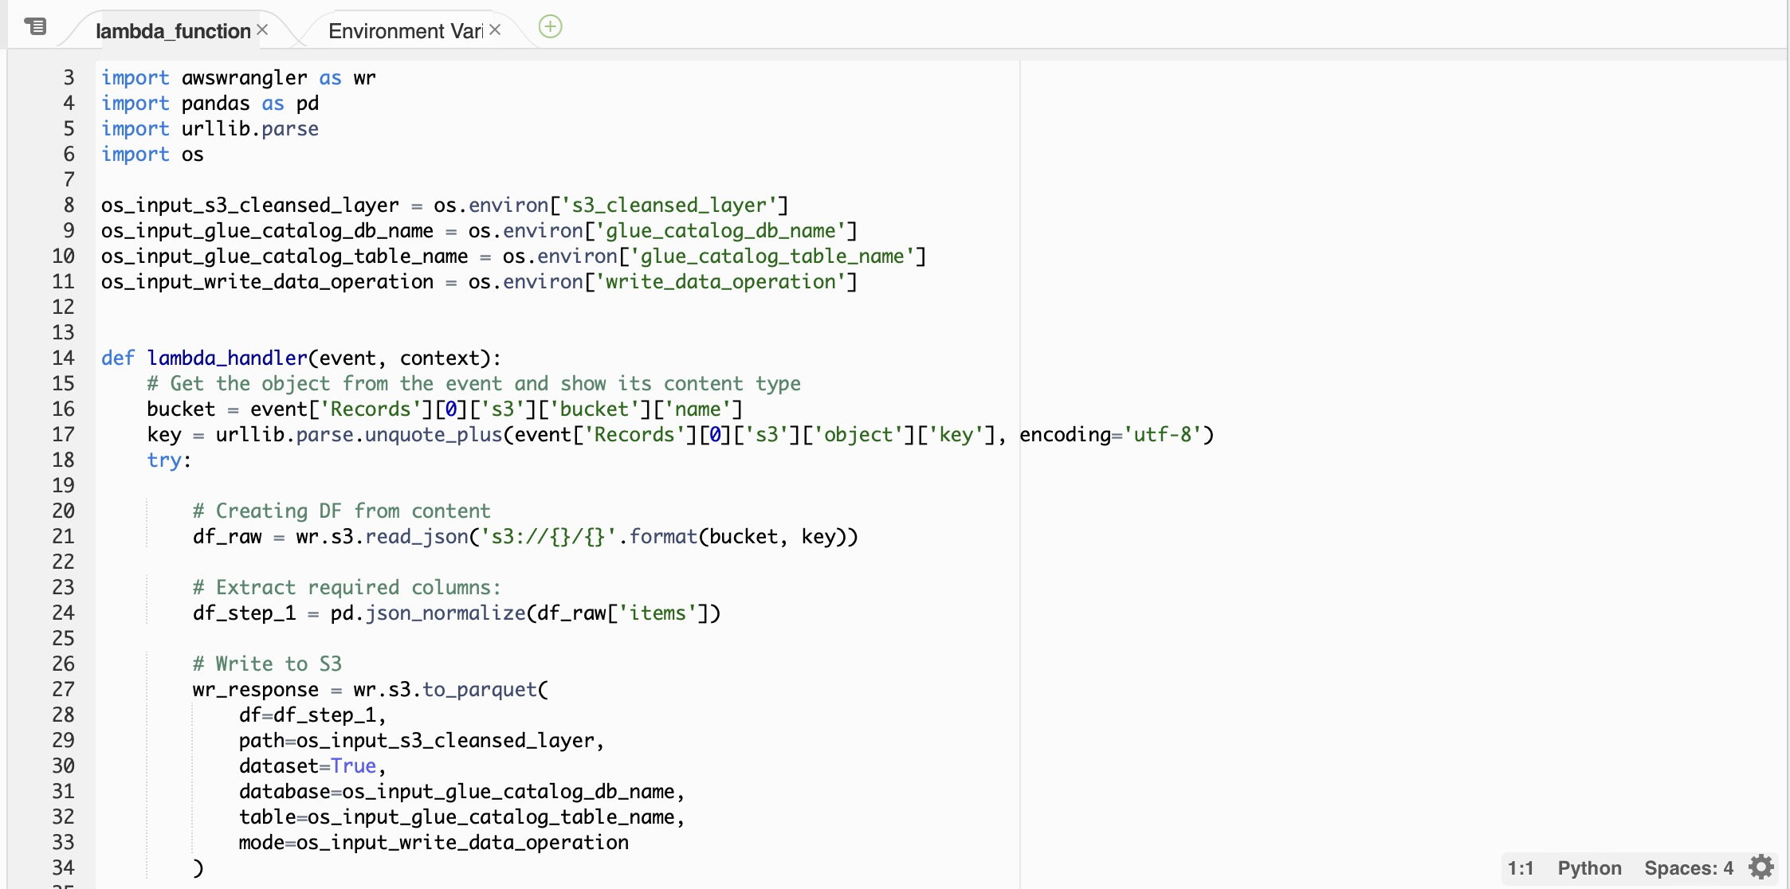
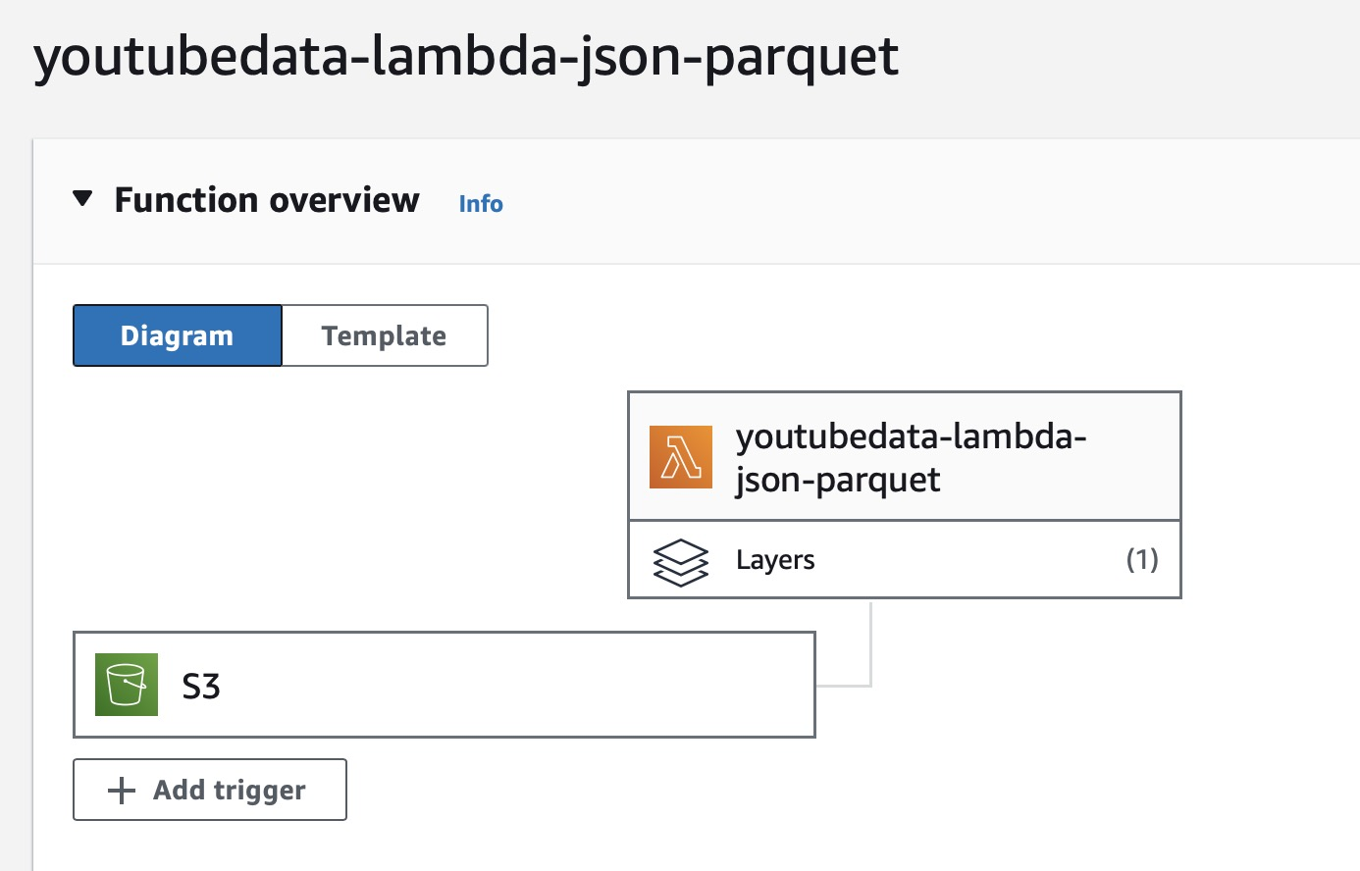
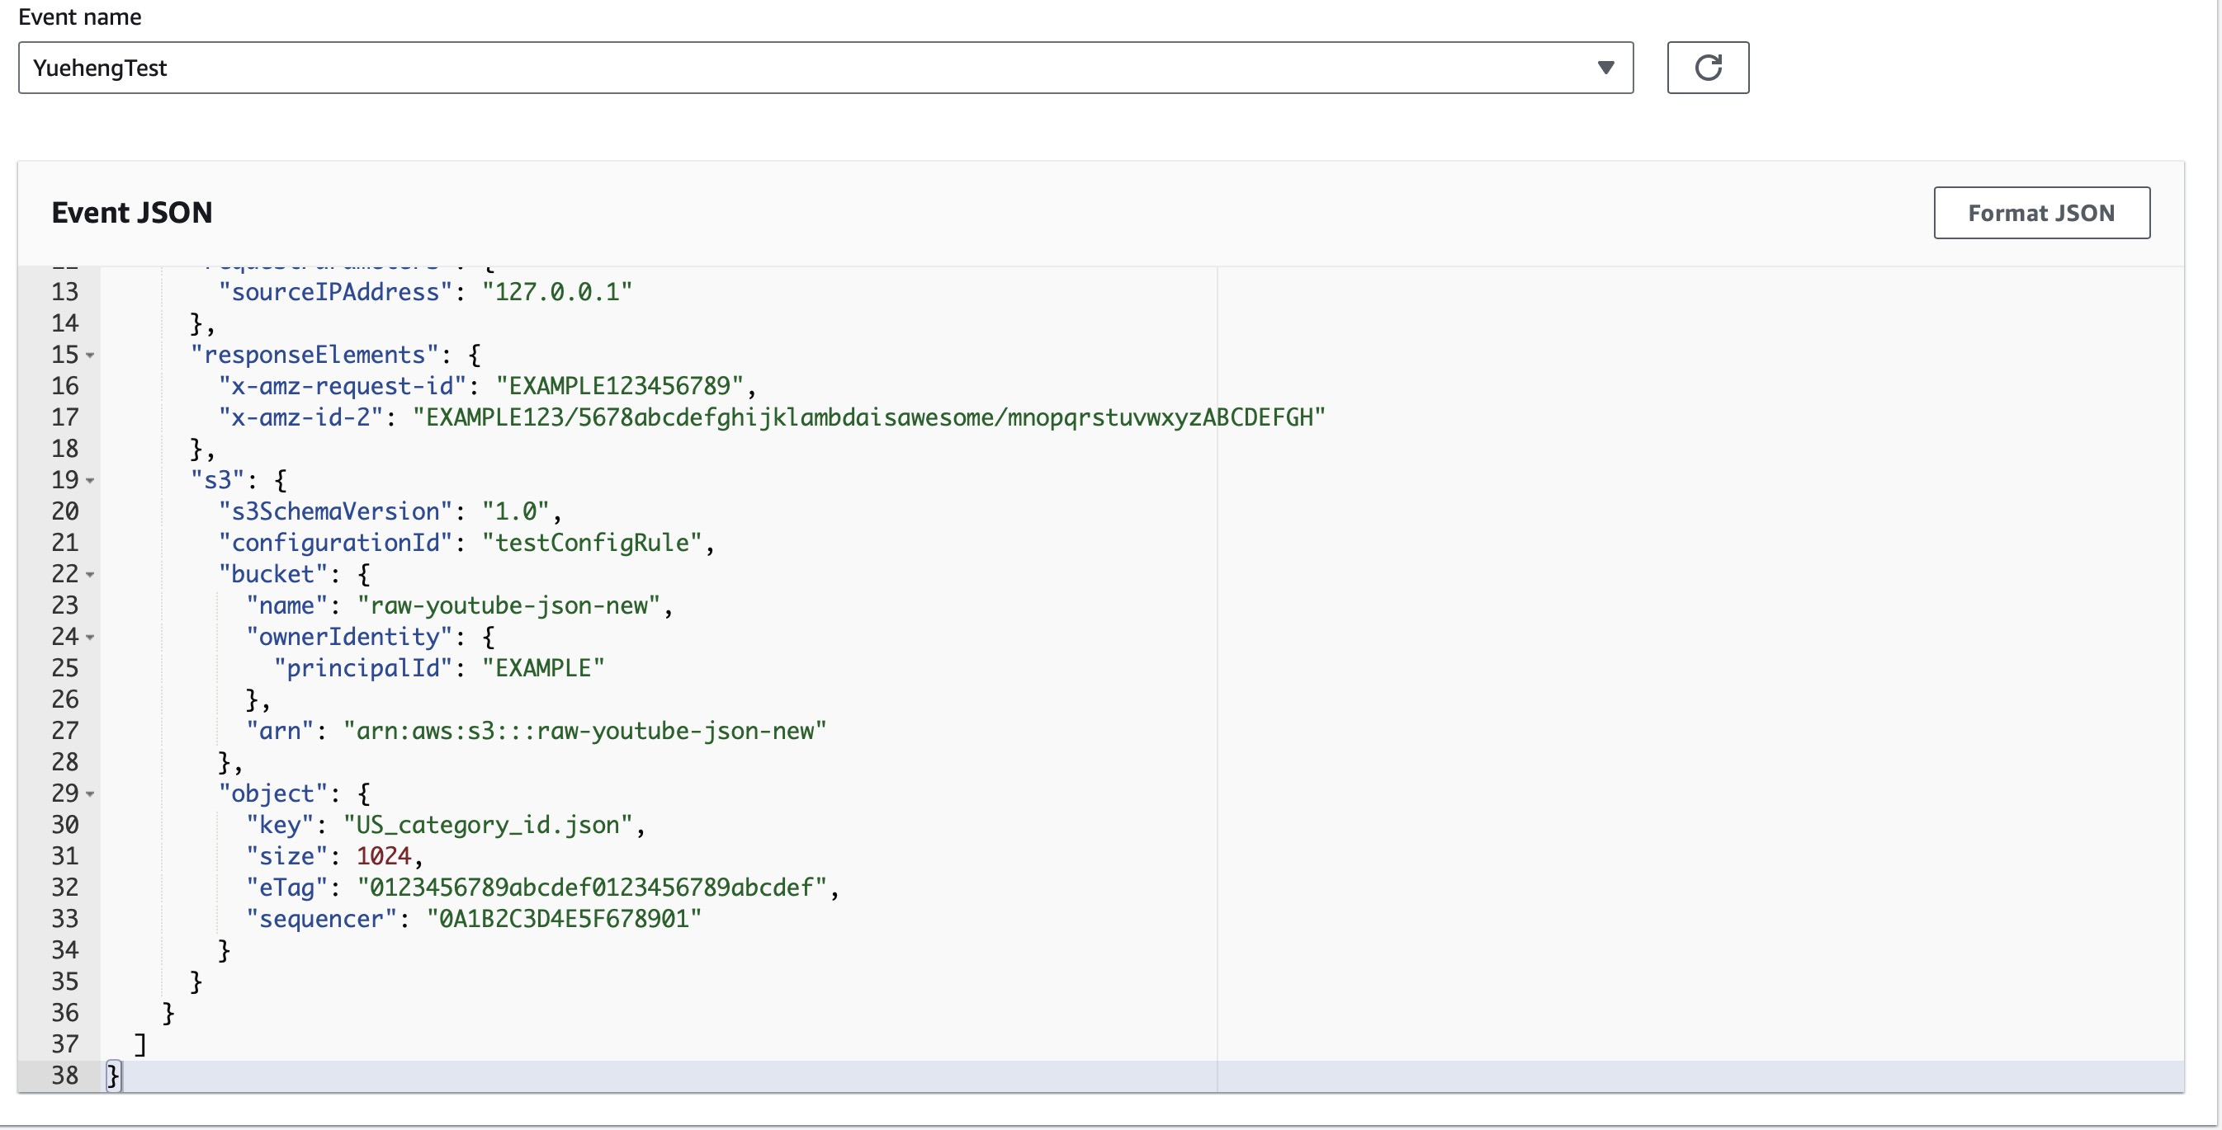
Lambda Function1 JSON - Parquet
Test Case
Notes:
The reason for converting JSON and CSV files into Parquet format often revolves around efficiency and cost in both storage and computation, especially in the context of big data processing and cloud environments like AWS.
Here's a simple explanation:
Storage Efficiency: Parquet is a columnar storage format, which means it stores data by column rather than by row. This allows for better compression and reduced storage costs because similar data is stored together.
Cost-Effective: Since you pay for the amount of data scanned in many AWS services (like Amazon Athena), Parquet can reduce costs as it allows for efficient data skipping. If a query only needs to access certain columns, Parquet files can be read much faster as only necessary columns are accessed.
Performance: Query performance is improved with Parquet because I/O is minimized, and decompression is efficient. This is especially important when dealing with large datasets.
Compatibility: Parquet is supported by many data processing tools, including AWS services like Amazon Athena, Amazon Redshift Spectrum, and AWS Glue, as well as open-source data tools like Apache Spark and Hadoop.
In short, using Parquet can lead to faster query times, lower storage costs, and overall more efficient data processing workflows, which is particularly beneficial when processing large volumes of data for analytics and reporting purposes.

Slide 18
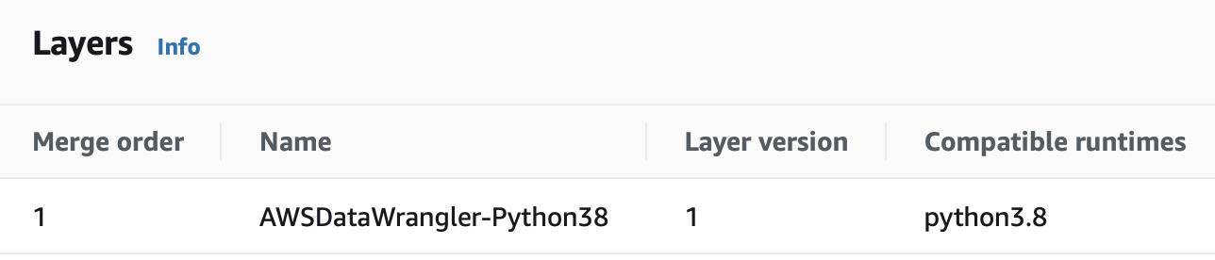
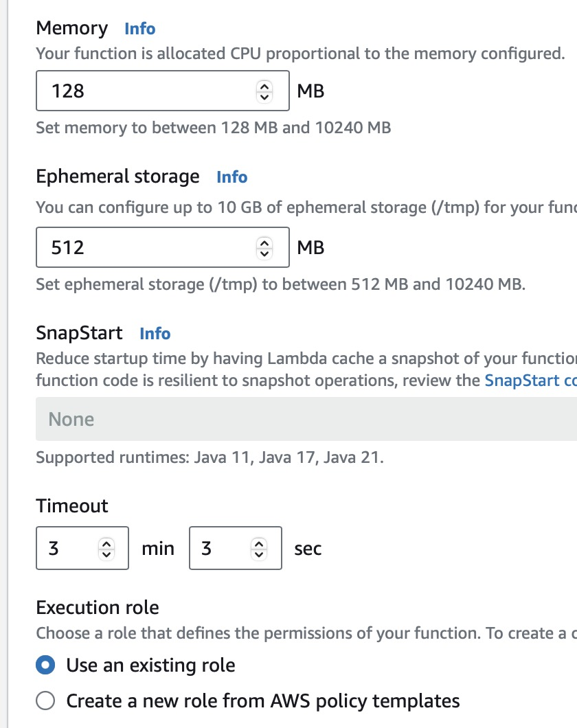
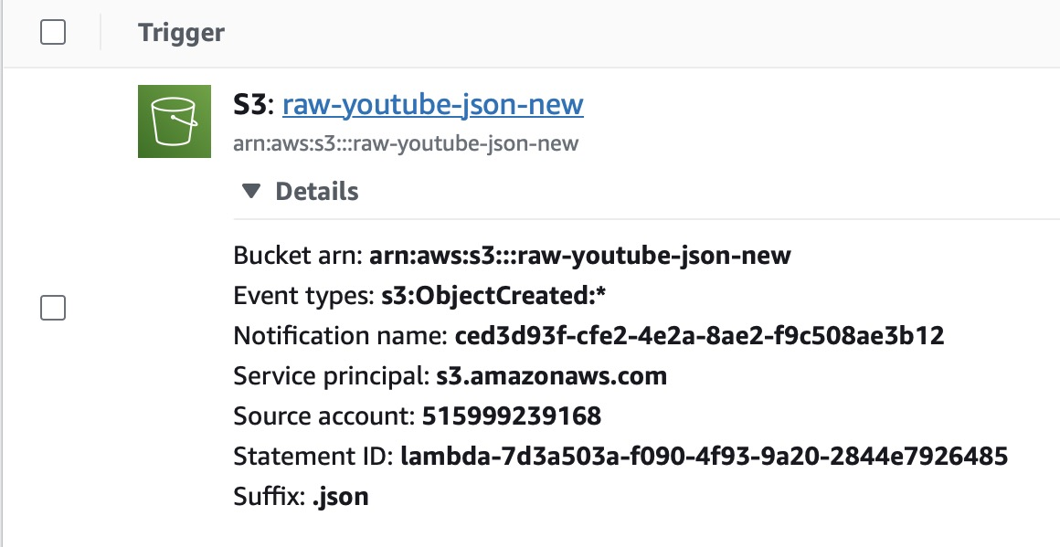
Lambda Trigger and Configuration:
Wrangler Layers
Event Based Trigger
Configuration
Notes:
Event-Driven: Lambda functions are triggered by specific events from many AWS services, like S3 uploads and modification
Language Support: Supports multiple programming languages, including Node.js, Python, Ruby, Java, Go, .NET Core, and custom runtimes.
Customizable: Lambda allows you to bring in your own libraries, even native ones, or package your function as a container image.
Performance Monitoring: Integration with AWS CloudWatch to monitor and log your Lambda functions' performance.
Cost-Effective: With Lambda, you pay only for the compute time you consume. There's no charge when your code isn't running.

Slide 19

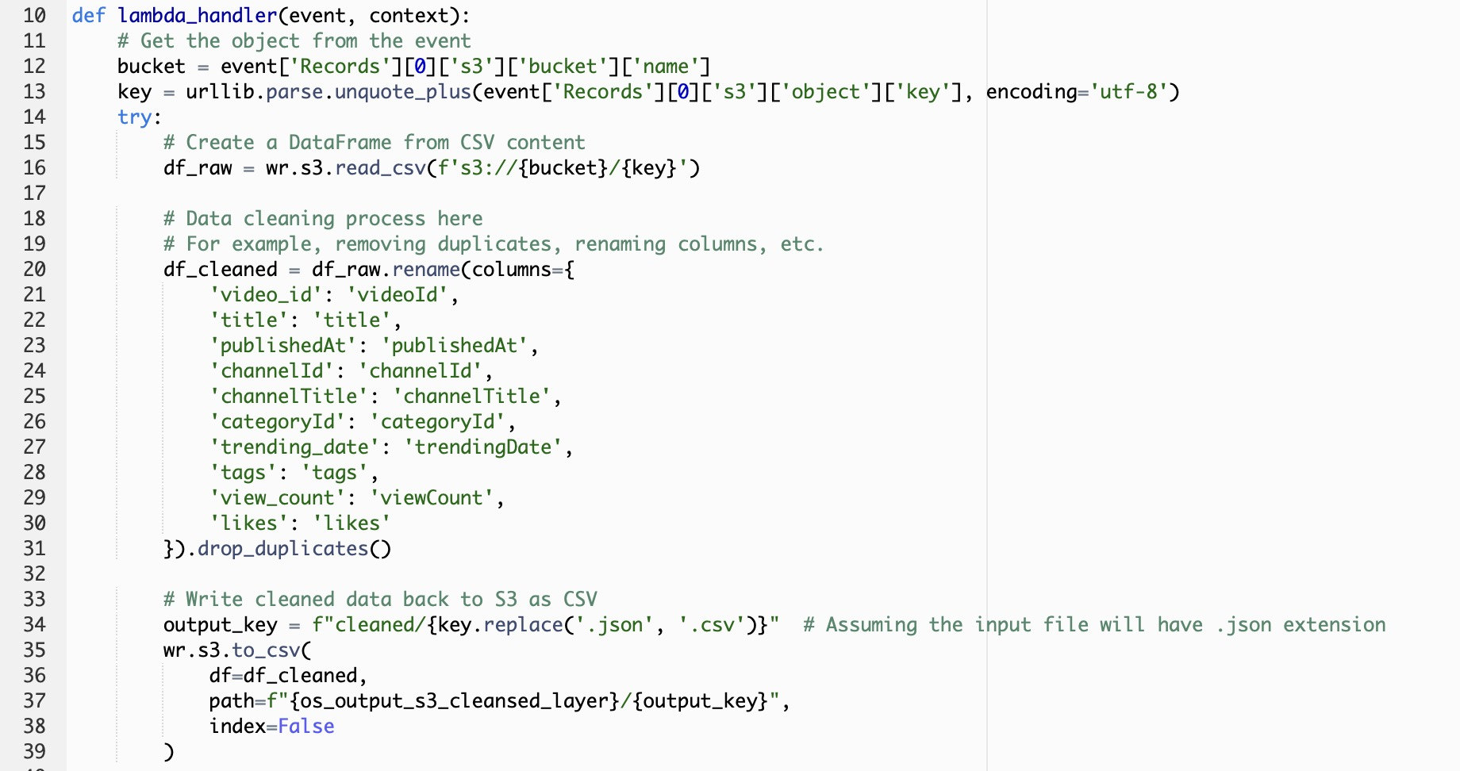
Lambda Function2: CSV Cleaning
Notes:
Event-Driven: Lambda functions are triggered by specific events from many AWS services, like S3 uploads and modification
Language Support: Supports multiple programming languages, including Node.js, Python, Ruby, Java, Go, .NET Core, and custom runtimes.
Customizable: Lambda allows you to bring in your own libraries, even native ones, or package your function as a container image.
Performance Monitoring: Integration with AWS CloudWatch to monitor and log your Lambda functions' performance.
Cost-Effective: With Lambda, you pay only for the compute time you consume. There's no charge when your code isn't running.

Slide 20
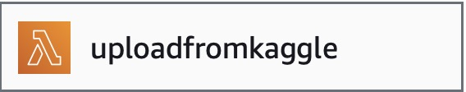
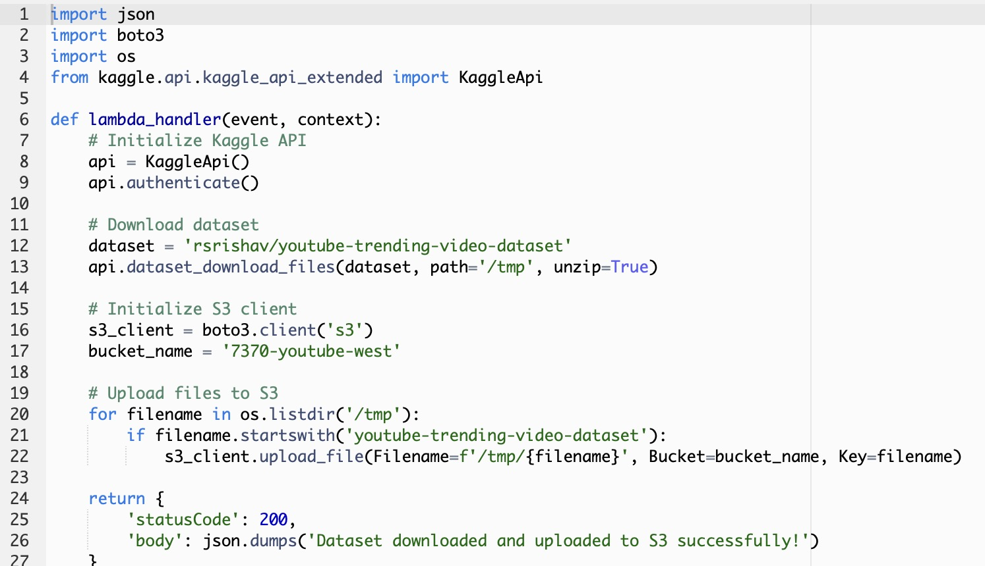
Lambda Function3: Auto Kaggle Uploading(Unfinished)
Notes:
Event-Driven: Lambda functions are triggered by specific events from many AWS services, like S3 uploads and modification
Language Support: Supports multiple programming languages, including Node.js, Python, Ruby, Java, Go, .NET Core, and custom runtimes.
Customizable: Lambda allows you to bring in your own libraries, even native ones, or package your function as a container image.
Performance Monitoring: Integration with AWS CloudWatch to monitor and log your Lambda functions' performance.
Cost-Effective: With Lambda, you pay only for the compute time you consume. There's no charge when your code isn't running.

Slide 21
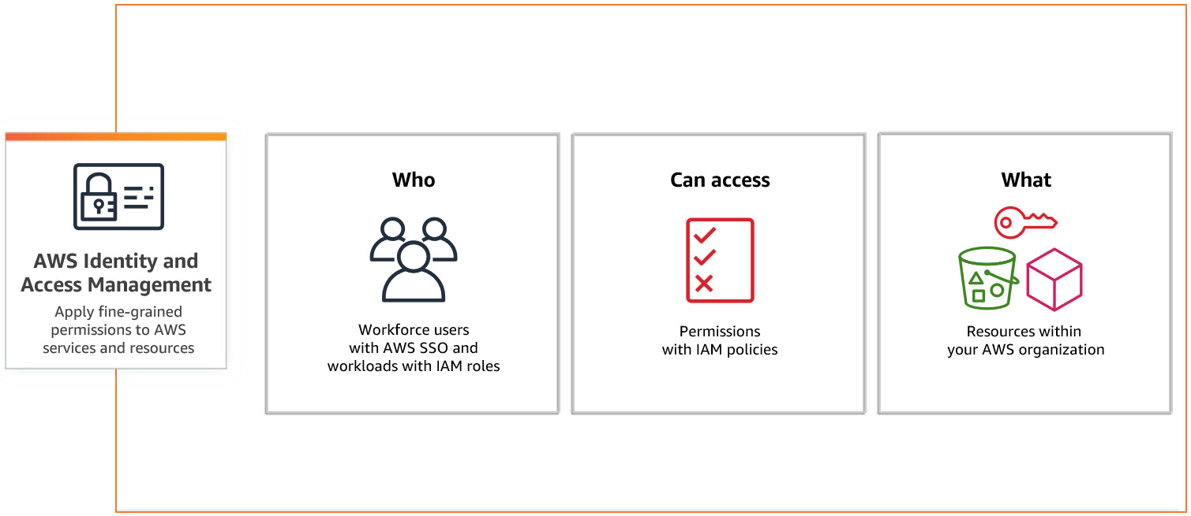
AWS Identity and Access Management
Notes:
Event-Driven: Lambda functions are triggered by specific events from many AWS services, like S3 uploads and modification
Language Support: Supports multiple programming languages, including Node.js, Python, Ruby, Java, Go, .NET Core, and custom runtimes.
Customizable: Lambda allows you to bring in your own libraries, even native ones, or package your function as a container image.
Performance Monitoring: Integration with AWS CloudWatch to monitor and log your Lambda functions' performance.
Cost-Effective: With Lambda, you pay only for the compute time you consume. There's no charge when your code isn't running.

Slide 22
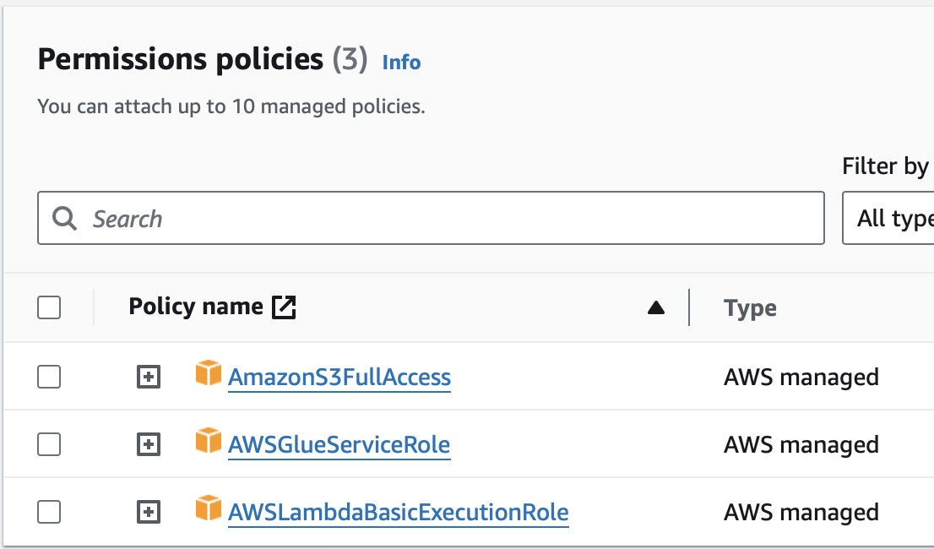
AWS IAM Permission Example
Notes:
Event-Driven: Lambda functions are triggered by specific events from many AWS services, like S3 uploads and modification
Language Support: Supports multiple programming languages, including Node.js, Python, Ruby, Java, Go, .NET Core, and custom runtimes.
Customizable: Lambda allows you to bring in your own libraries, even native ones, or package your function as a container image.
Performance Monitoring: Integration with AWS CloudWatch to monitor and log your Lambda functions' performance.
Cost-Effective: With Lambda, you pay only for the compute time you consume. There's no charge when your code isn't running.

Slide 23
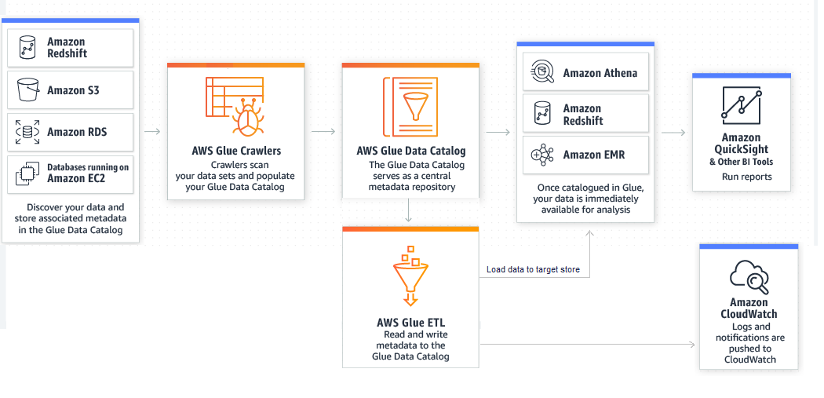
What is AWS Glue?
Notes:
AWS Glue is a fully managed extract, transform, and load (ETL) service that makes it easy for customers to prepare and load their data for analytics. It's a part of Amazon Web Services (AWS), a comprehensive cloud computing platform. Here are some key features and aspects of AWS Glue:
Data Integration: AWS Glue simplifies the process of integrating data from various sources, preparing it for analysis, and loading it into data stores.
Serverless Service: It's serverless, which means it automatically provisions the environment needed for the job, eliminating the need for server management by the user.
ETL Script Generation: AWS Glue automatically generates the code needed to execute data transformations. It's based on PySpark (Python API for Apache Spark) but also supports Scala.

Slide 24
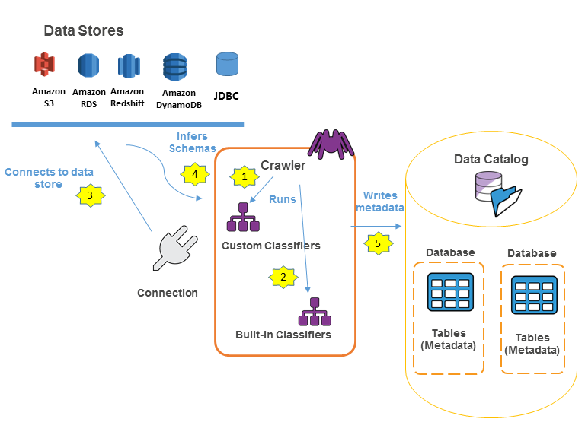
AWS Glue Crawler / Data Catalog Database
AWS Glue Crawler
Data Discovery
Classification
Data Catalog
Integration
Notes:
AWS Glue Crawler: Automatically discovers and profiles your data via custom or built-in classifiers to recognize various formats and types.
Data Discovery: Connects to data stores such as Amazon S3, RDS, Redshift, and DynamoDB, automatically inferring schema and data types.
Classification: Uses classifiers to categorize data formats, enabling Glue to understand the structure of your data for processing.
Metadata Storage: Writes metadata to the AWS Glue Data Catalog, creating a persistent metadata store for your data assets.
Data Catalog: Centralized repository to store structural and operational metadata for all your data assets, making data searchable and queryable.
Integration: Seamlessly integrates with other AWS analytics and management services to enable a serverless data integration service.
Serverless: Fully managed service that requires no user-provisioned resources, reducing the operational overhead of data cataloging.
Scalability: Scales to accommodate data cataloging and search operations for datasets ranging from small to petabyte-scale.

Slide 25
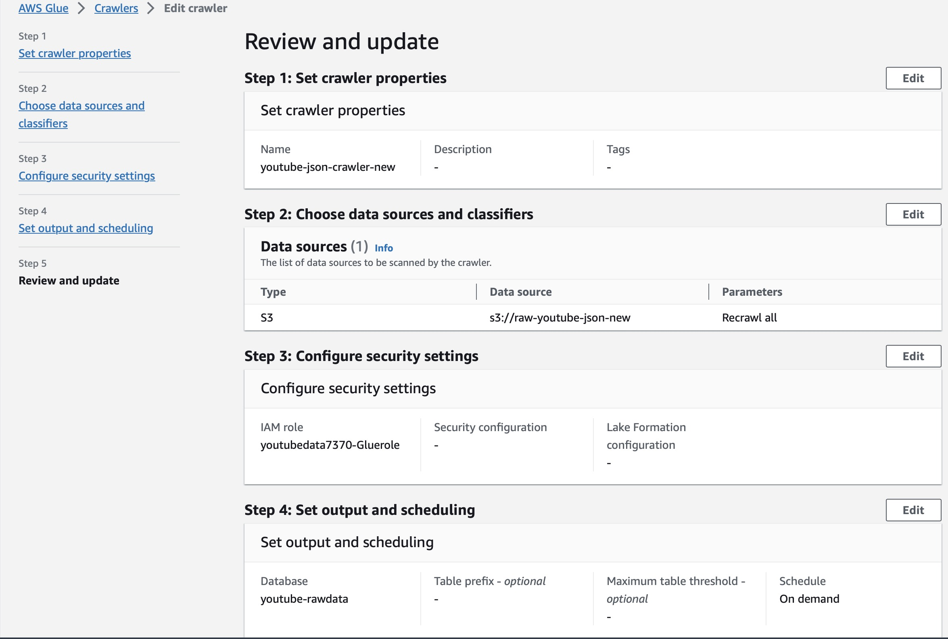
AWS Glue Crawler / Data Catalog Database
AWS Glue Crawler
Data Discovery
Classification
Data Catalog Database
Integration
Notes:
AWS Glue Crawler: Automatically discovers and profiles your data via custom or built-in classifiers to recognize various formats and types.
Data Discovery: Connects to data stores such as Amazon S3, RDS, Redshift, and DynamoDB, automatically inferring schema and data types.
Classification: Uses classifiers to categorize data formats, enabling Glue to understand the structure of your data for processing.
Metadata Storage: Writes metadata to the AWS Glue Data Catalog, creating a persistent metadata store for your data assets.
Data Catalog: Centralized repository to store structural and operational metadata for all your data assets, making data searchable and queryable.
Integration: Seamlessly integrates with other AWS analytics and management services to enable a serverless data integration service.
Serverless: Fully managed service that requires no user-provisioned resources, reducing the operational overhead of data cataloging.
Scalability: Scales to accommodate data cataloging and search operations for datasets ranging from small to petabyte-scale.

Slide 26
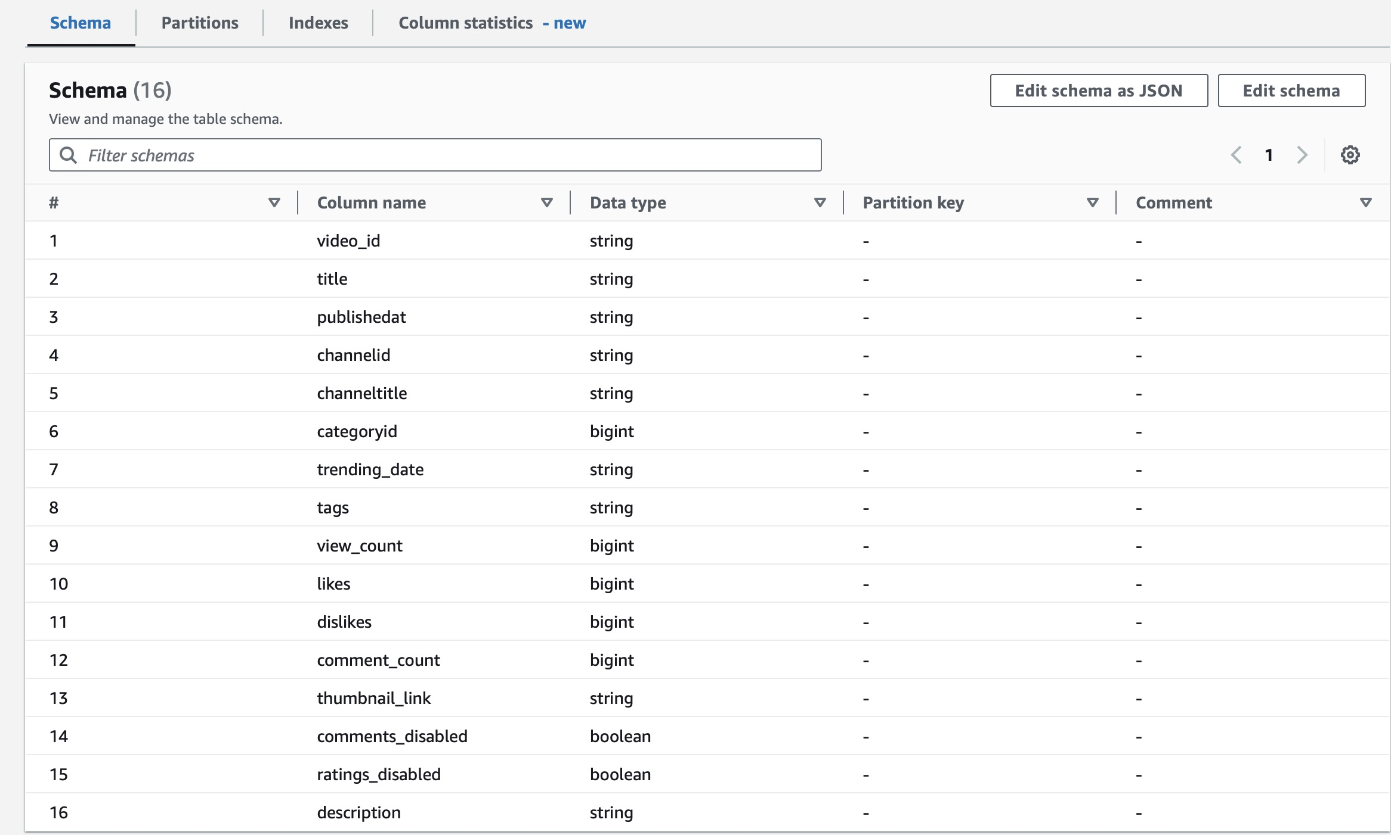
AWS Glue Crawler / Data Catalog Database
AWS Glue Crawler
Data Discovery
Classification
Table: Region=US
Data Catalog Database
Integration
Notes:
A schema, in the context of databases and data management, is a critical concept that refers to the organizational blueprint of a database or dataset. It defines how data is structured, organized, and related to each other. AWS Glue crawler can read the data file and give you the correct schema automatically.
Why is Schema Important?
Organization and Clarity
Data Integrity and Consistency
Efficiency in Data Retrieval
Ease of Scaling and Modification
Collaboration and Communication

Slide 27
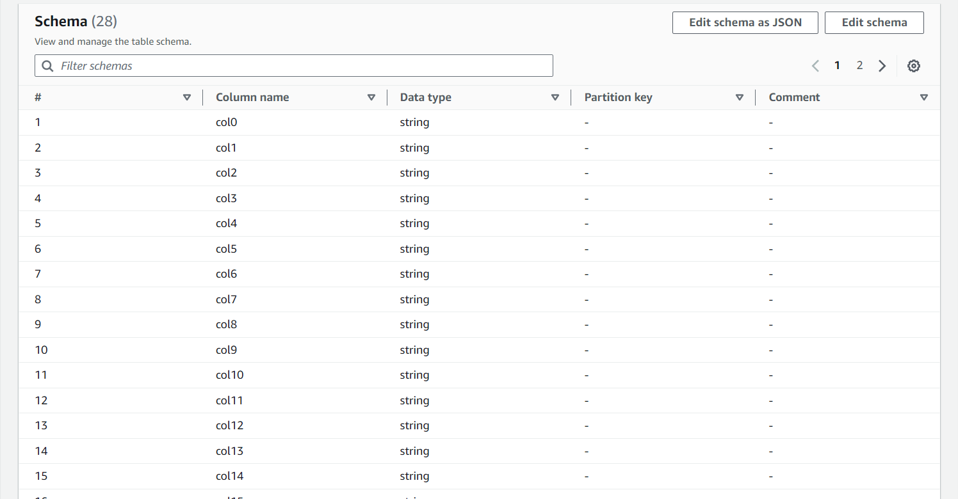
Schema
sometimes AWS doesn’t provide you correct Schema automatically
Like This :
Notes:
From the table we can see that, the schema is not correct and this is because the data is too big (325MB) and it is too complicated the crawler can’t read the header automatically.
To avoid that: 1, Divide data in to small dataset 2, if your dataset contains multiple files, they must adhere to a consistent format and structure 3,Check the hidden character and hidden issues. 4 USE CLASSIFIER

Slide 28
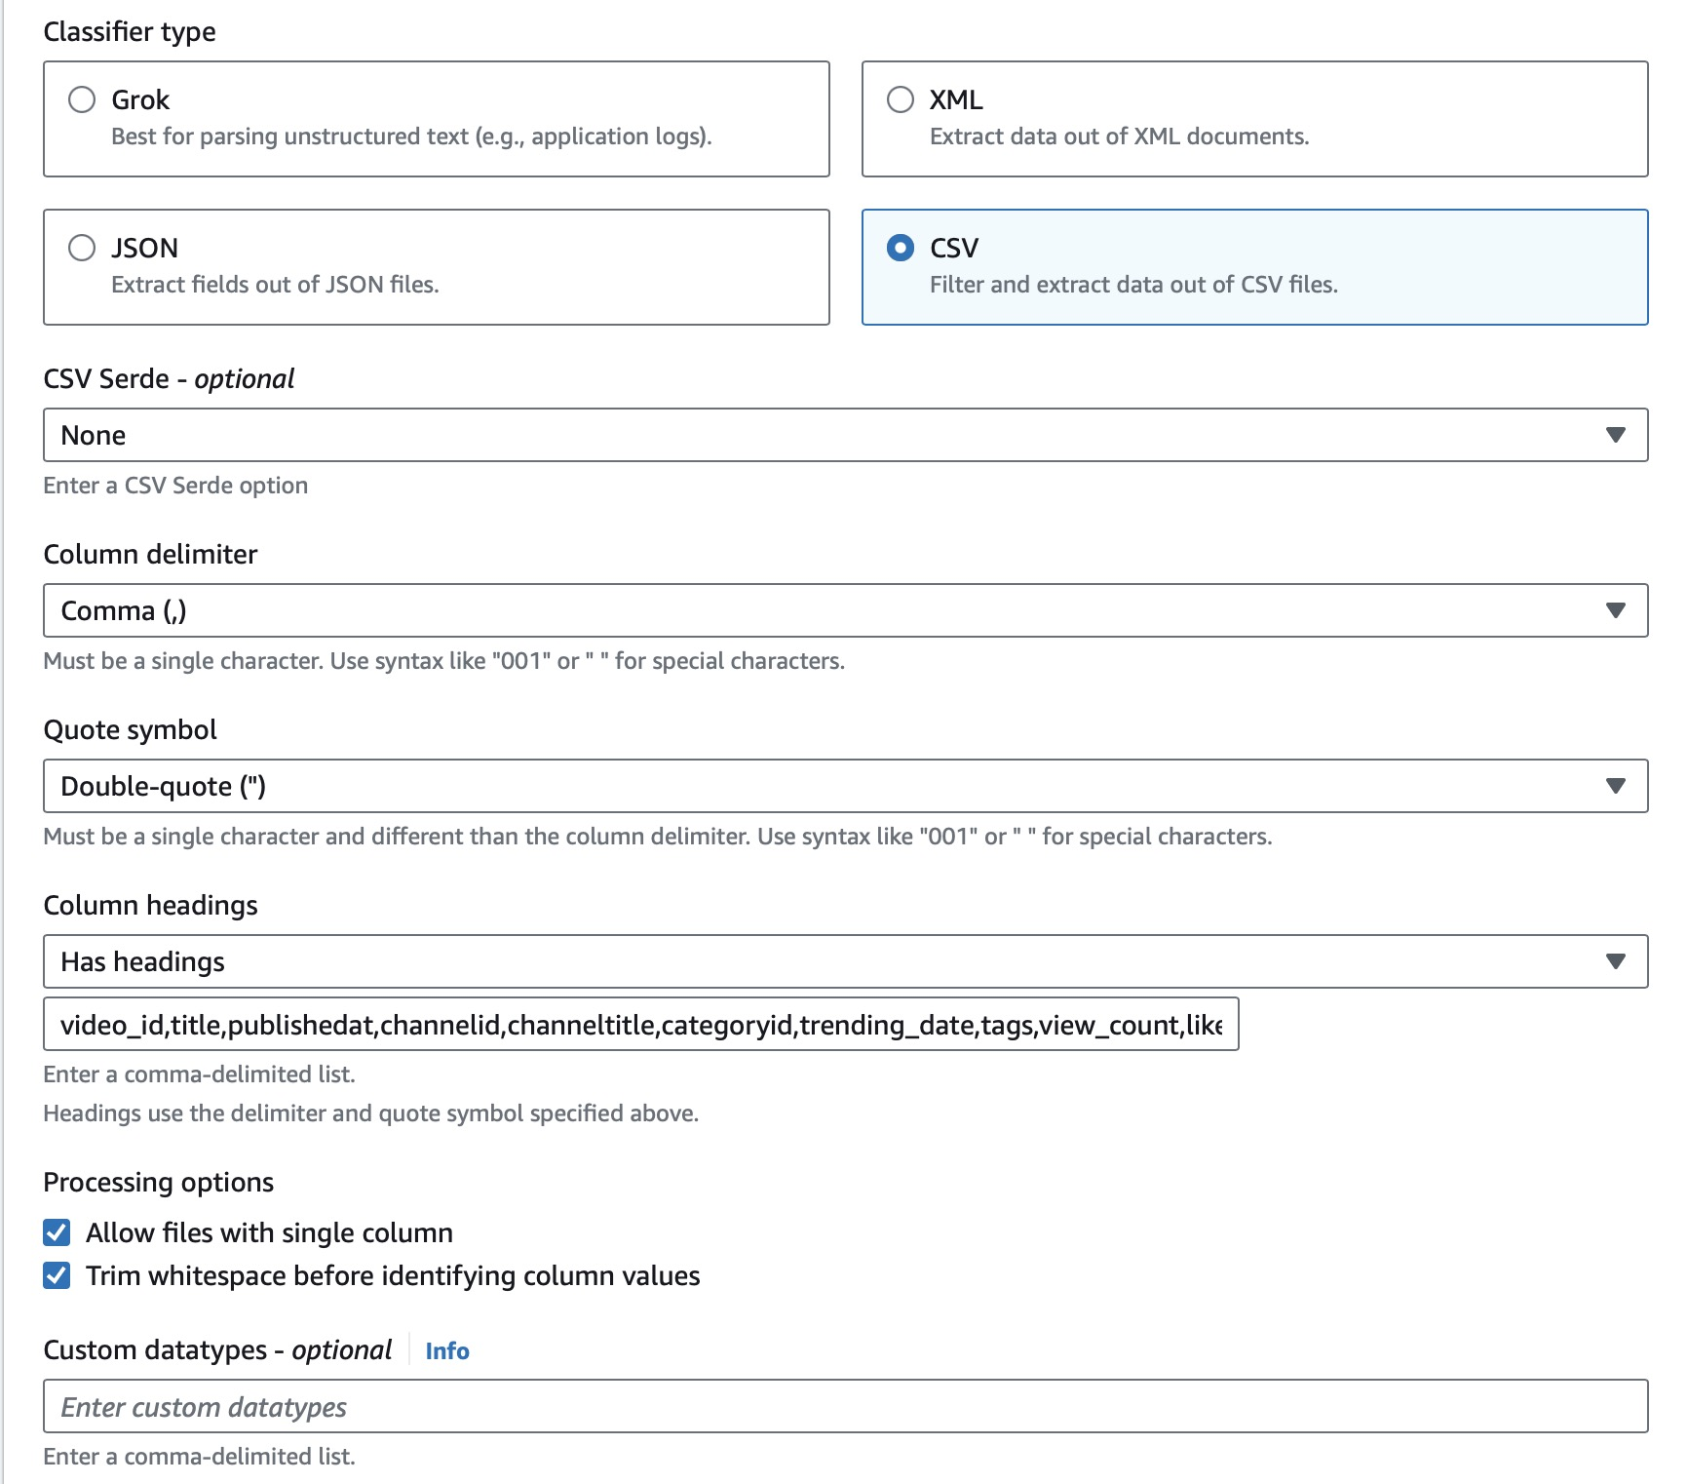
AWS Glue Crawler / Data Catalog Database
AWS Glue Crawler
Data Discovery
Classification
Data Catalog Database
Integration
Notes:
Classfier is a custom data(schema) interpret tool or mechanism in Glue, which helps Glue crawler interpret the data correctly.
1 Detect heading, 2 has heading, 3 no heading

Slide 29
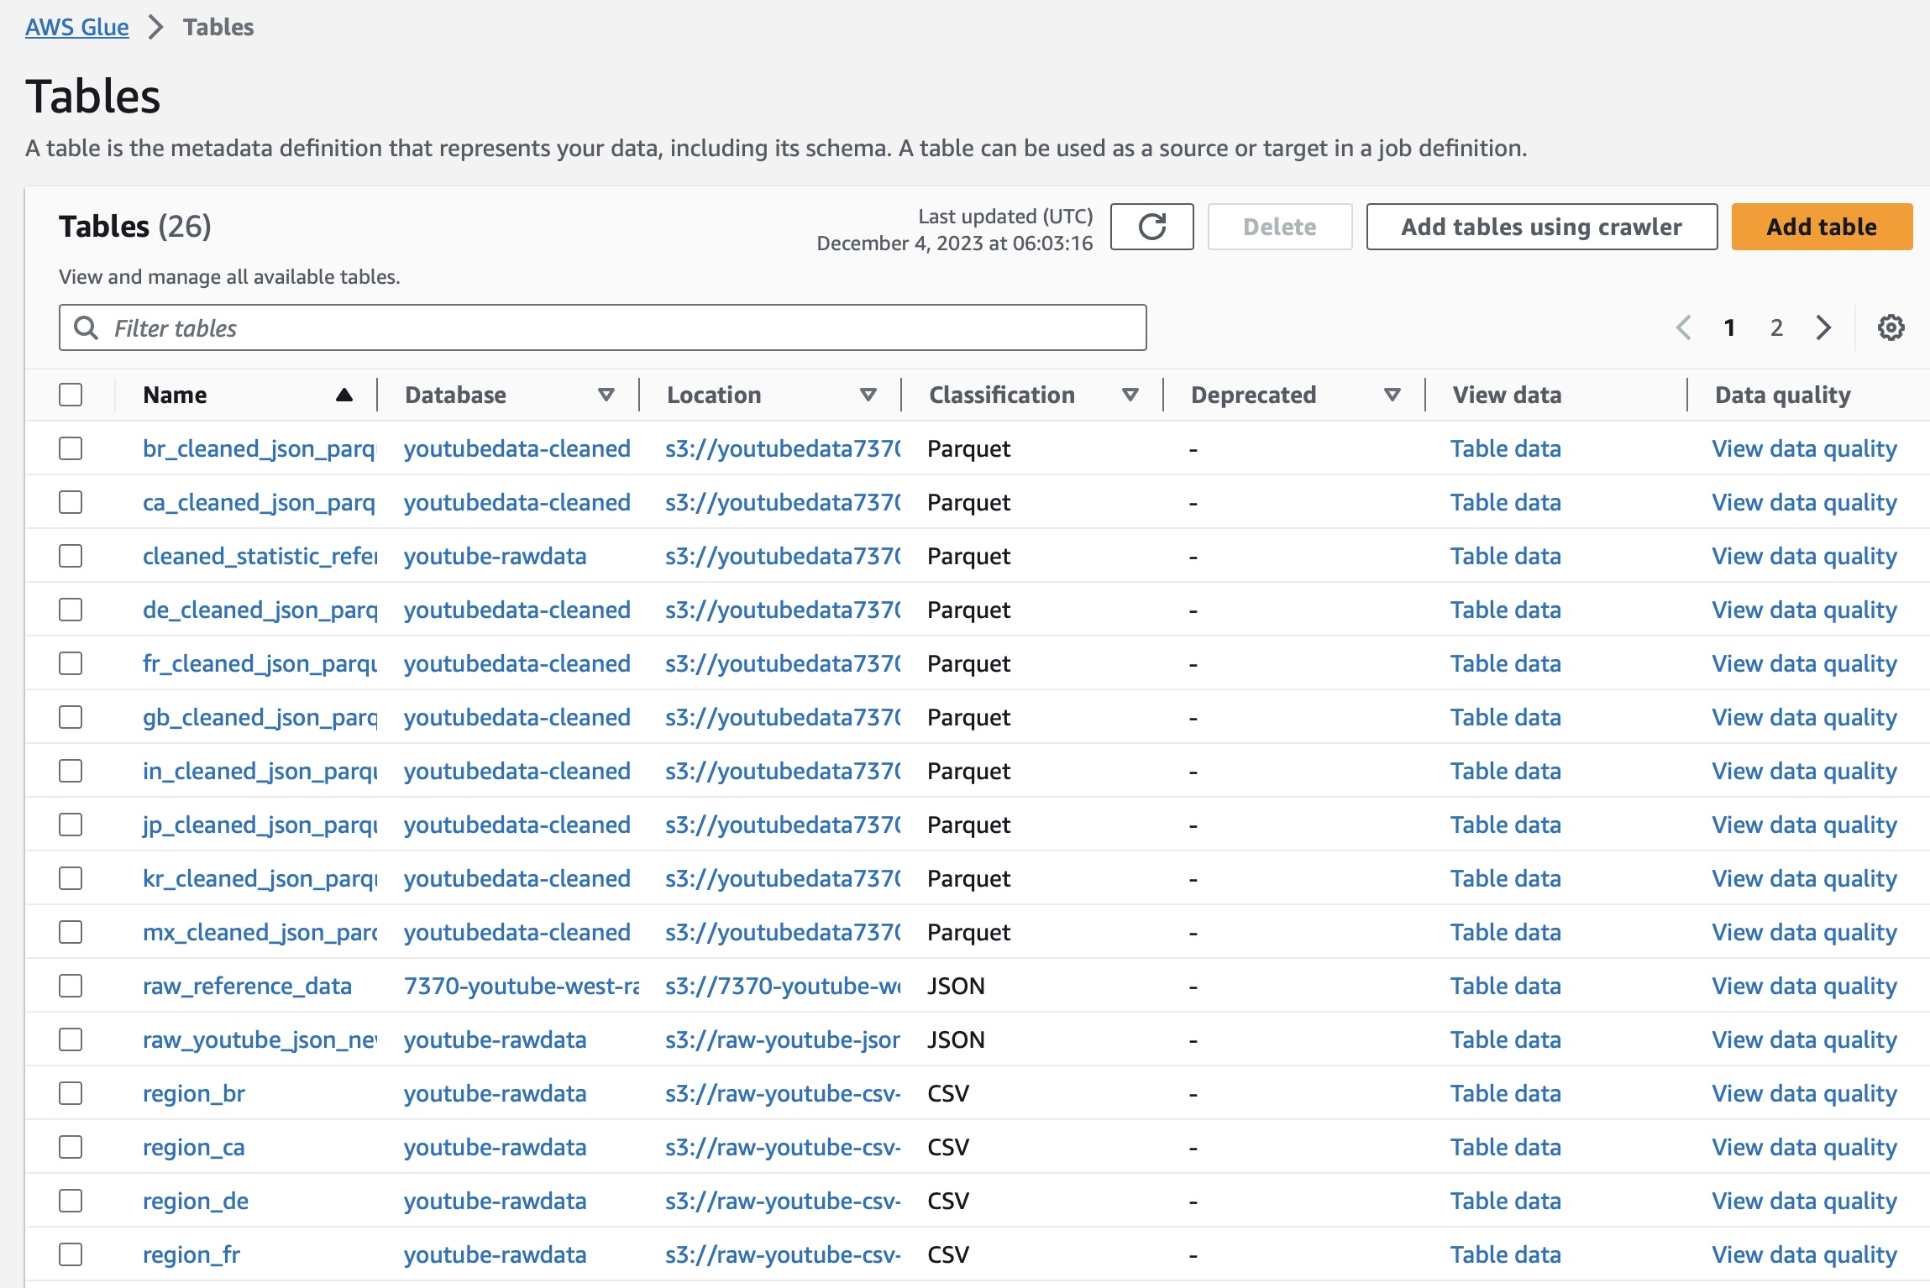
AWS Glue Crawler / Data Catalog Database
AWS Glue Crawler
Data Discovery
Classification
Data Catalog Database
Integration
Notes:
AWS Glue Crawler: Automatically discovers and profiles your data via custom or built-in classifiers to recognize various formats and types.
Data Discovery: Connects to data stores such as Amazon S3, RDS, Redshift, and DynamoDB, automatically inferring schema and data types.
Classification: Uses classifiers to categorize data formats, enabling Glue to understand the structure of your data for processing.
Metadata Storage: Writes metadata to the AWS Glue Data Catalog, creating a persistent metadata store for your data assets.
Data Catalog: Centralized repository to store structural and operational metadata for all your data assets, making data searchable and queryable.
Integration: Seamlessly integrates with other AWS analytics and management services to enable a serverless data integration service.
Serverless: Fully managed service that requires no user-provisioned resources, reducing the operational overhead of data cataloging.
Scalability: Scales to accommodate data cataloging and search operations for datasets ranging from small to petabyte-scale.

Slide 30
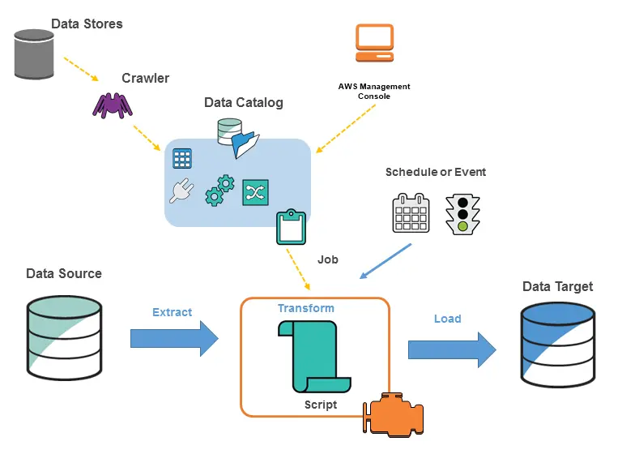
AWS Glue Crawler / Data Catalog Database
AWS Glue Crawler
Data Discovery
Classification
Data Catalog
Integration
Notes:
Integration: Seamlessly integrates with other AWS analytics and management services to enable a serverless data integration service.
With Data Catalog we can integration the data by AWS builtin algorithm such as we can use Athena to write query directly, or use quicksight to intepret data directly and also use Glue Studio ETL pipeline to do ETL process.

Slide 31
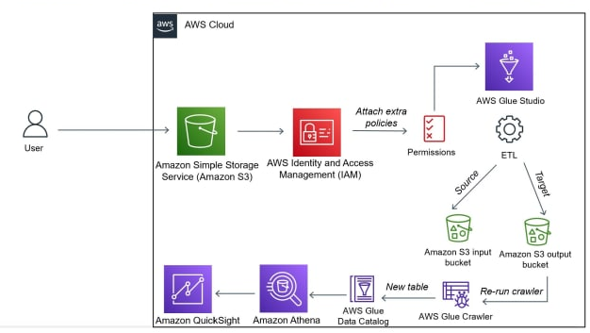
AWS Glue Studio
Notes:
Event-Driven: Lambda functions are triggered by specific events from many AWS services, like S3 uploads and modification
Language Support: Supports multiple programming languages, including Node.js, Python, Ruby, Java, Go, .NET Core, and custom runtimes.
Customizable: Lambda allows you to bring in your own libraries, even native ones, or package your function as a container image.
Performance Monitoring: Integration with AWS CloudWatch to monitor and log your Lambda functions' performance.
Cost-Effective: With Lambda, you pay only for the compute time you consume. There's no charge when your code isn't running.

Slide 32
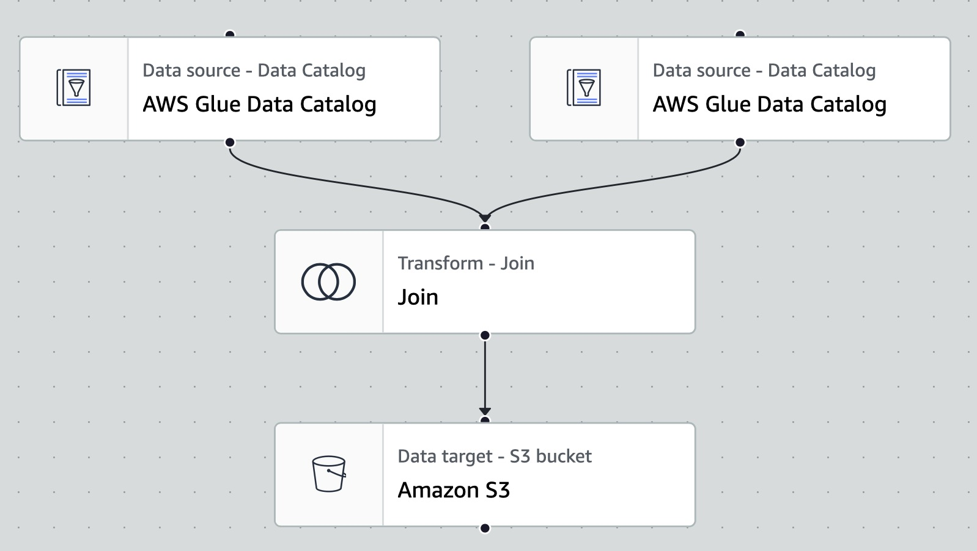
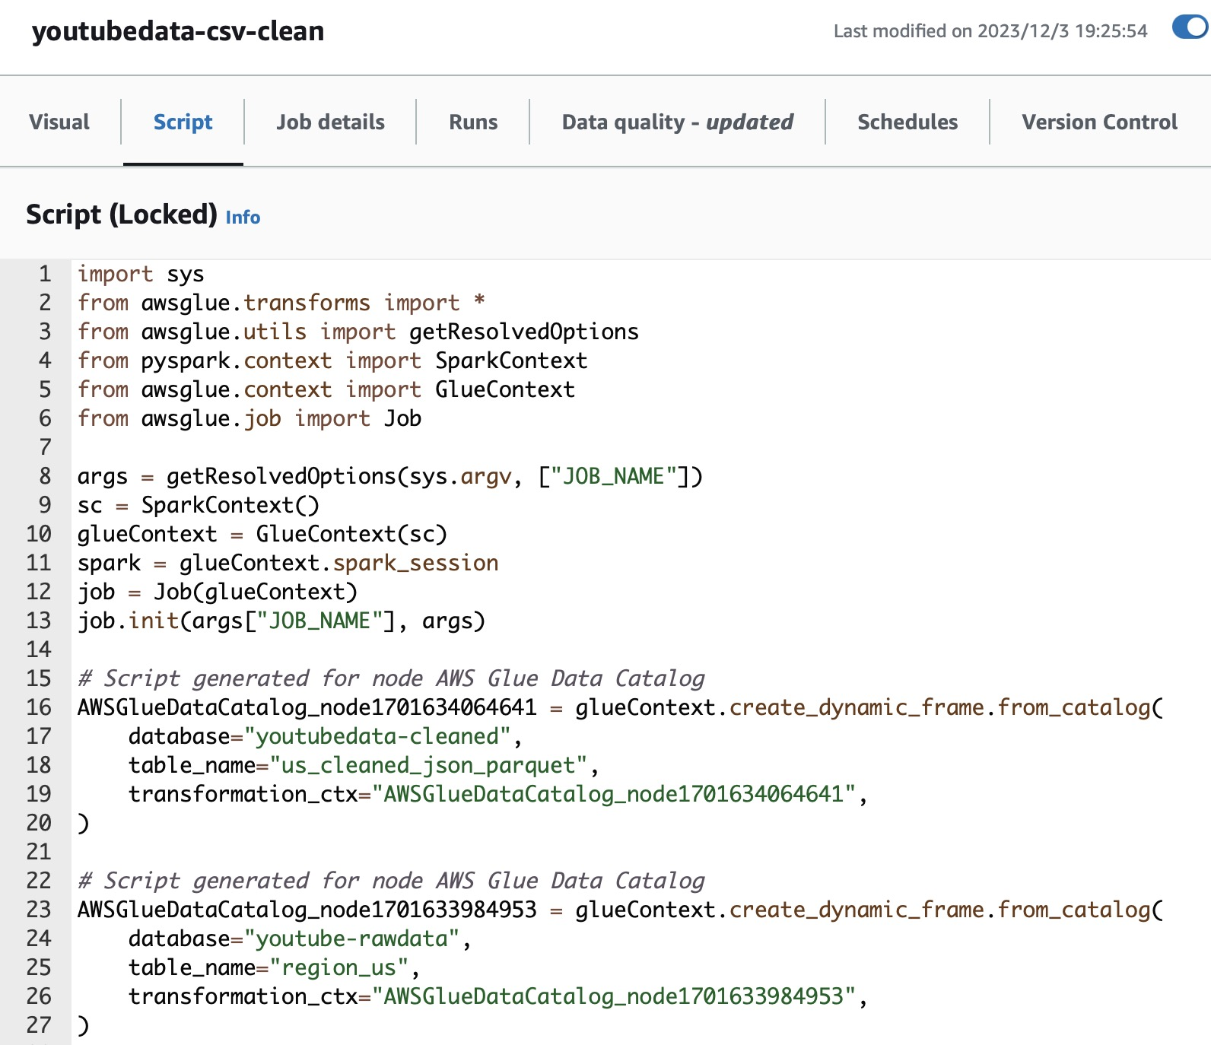
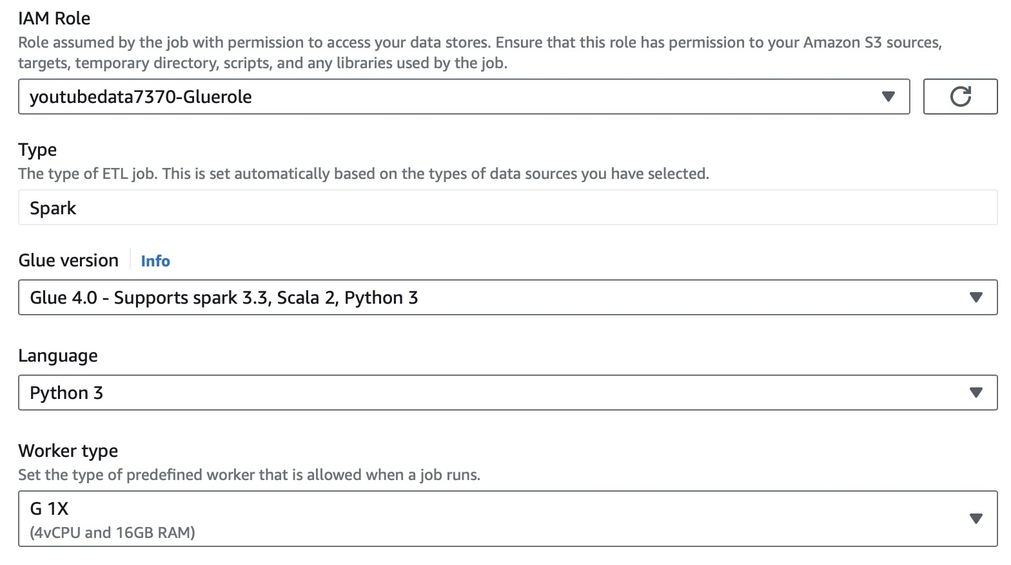
AWS Glue Studio-Visual ETL
Notes:
Event-Driven: Lambda functions are triggered by specific events from many AWS services, like S3 uploads and modification
Language Support: Supports multiple programming languages, including Node.js, Python, Ruby, Java, Go, .NET Core, and custom runtimes.
Customizable: Lambda allows you to bring in your own libraries, even native ones, or package your function as a container image.
Performance Monitoring: Integration with AWS CloudWatch to monitor and log your Lambda functions' performance.
Cost-Effective: With Lambda, you pay only for the compute time you consume. There's no charge when your code isn't running.

Slide 33
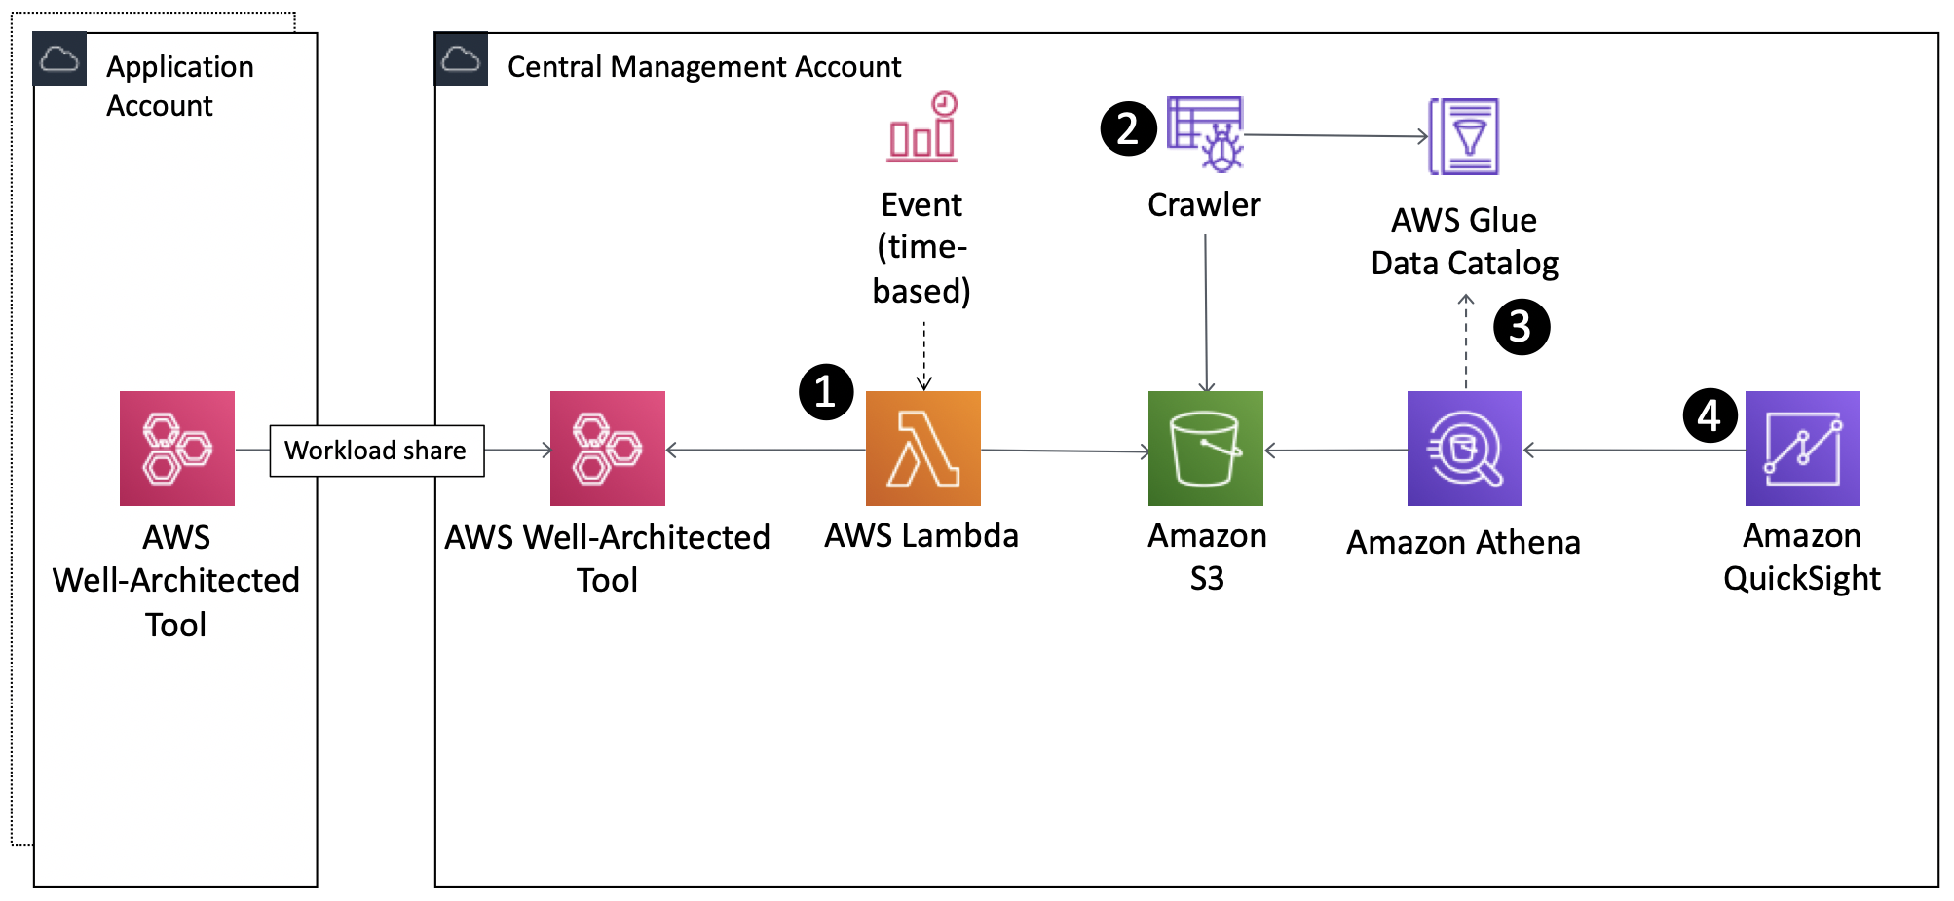
AWS Athena
Notes:
Amazon Athena is an interactive query service that makes it easy to analyze data directly in Amazon S3 using standard SQL. It's serverless, so there's no infrastructure to manage, and you pay only for the queries you run.

Slide 34
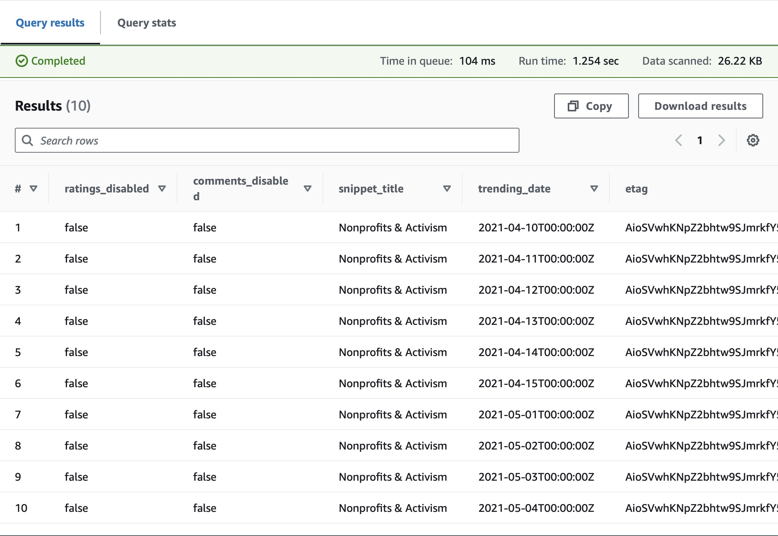
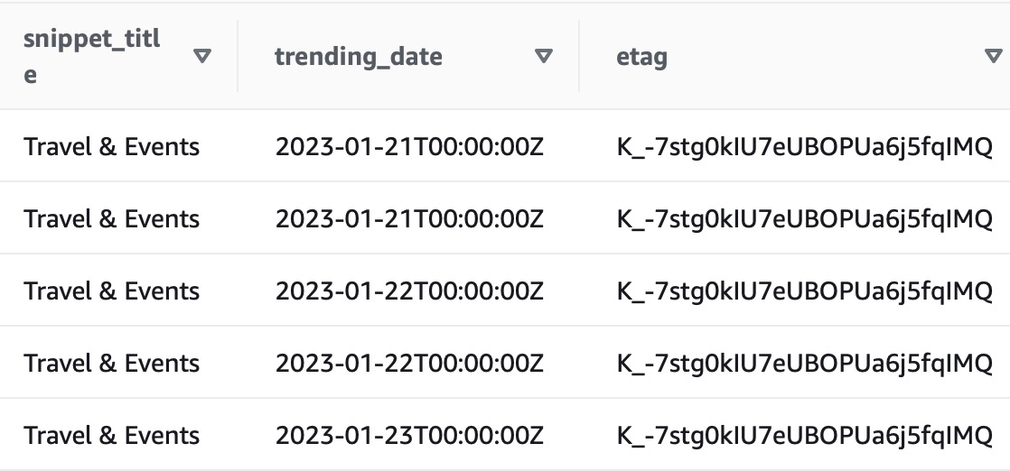
AWS Athena
SELECT * FROM "youtube-dataanalytic"."us.finaldata" u
WHERE "snippet_title"="Travel & Events"
limit 10;
SELECT * FROM "youtube-dataanalytic"."us.finaldata" limit 10;

Slide 35
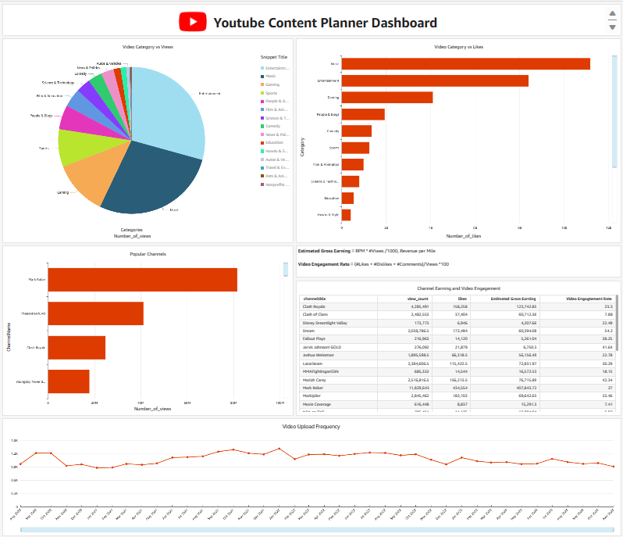
AWS QuickSight
QuickSight is a cloud-based business intelligence service that allows you to create and share interactive dashboards and reports. With QuickSight, you can connect to various data sources, such as AWS, SaaS applications, databases, and files.
QuickSight is designed to be fast, scalable, and cost-effective.
QuickSight is a great tool for anyone who wants to gain insights from their data and share them with others.
In our demonstration, we'll showcase how creators can effortlessly make informed decisions by leveraging the rapid and insightful analysis provided by our intuitive dashboard.

Slide 36
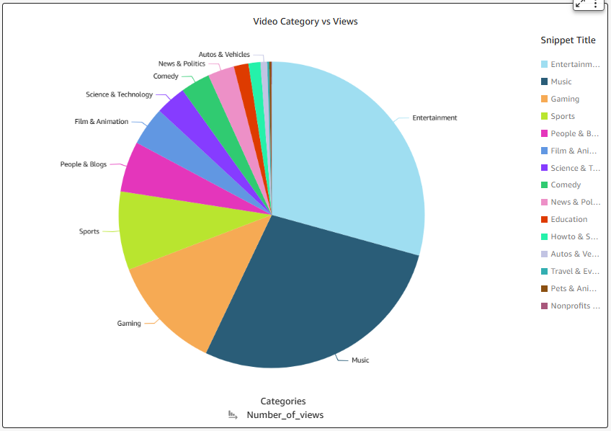
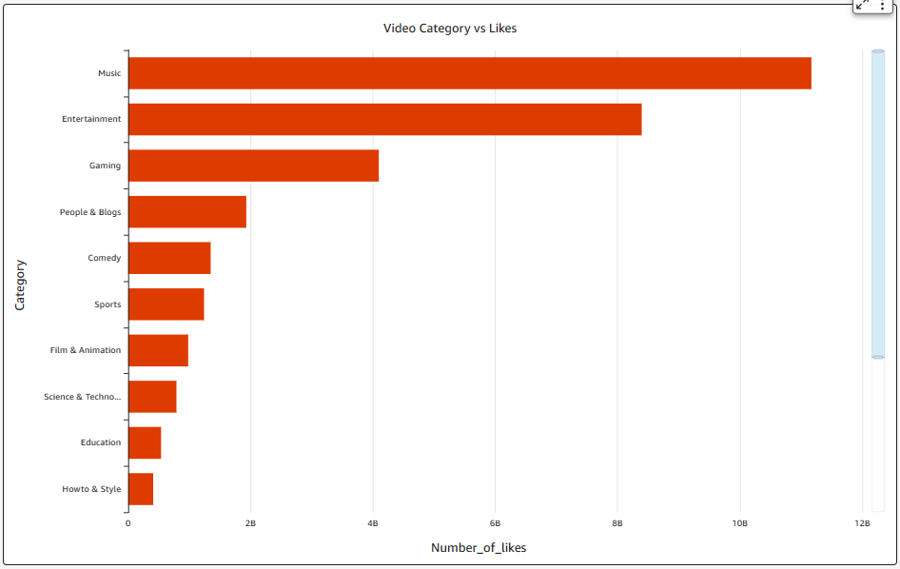

Slide 37
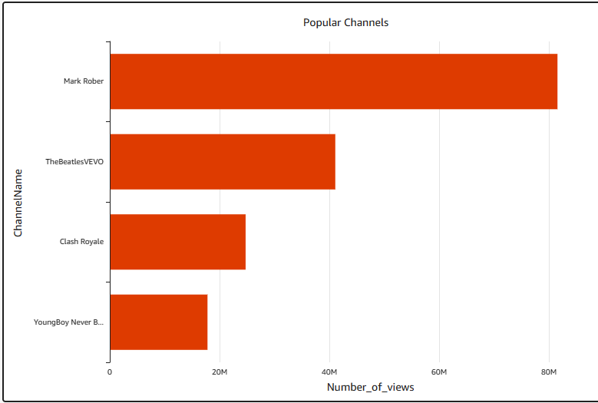
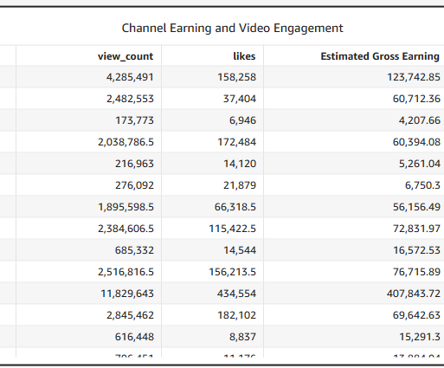
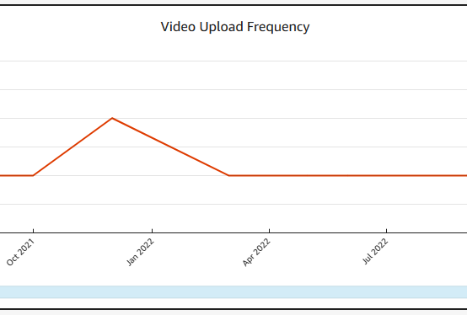

Slide 38
QuickSight Demo
https://us-east-1.quicksight.aws.amazon.com/sn/dashboards/9387c3d3-6ec5-4488-a06b-d3bc9cf1cd71

Slide 39
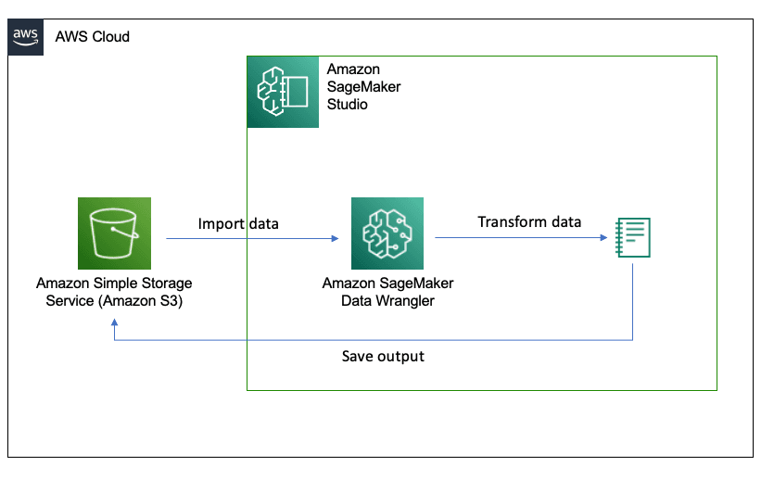
AWS SageMaker
I will now demonstrate how enterprises can harness data to significantly boost their revenue streams.

